Slide 1
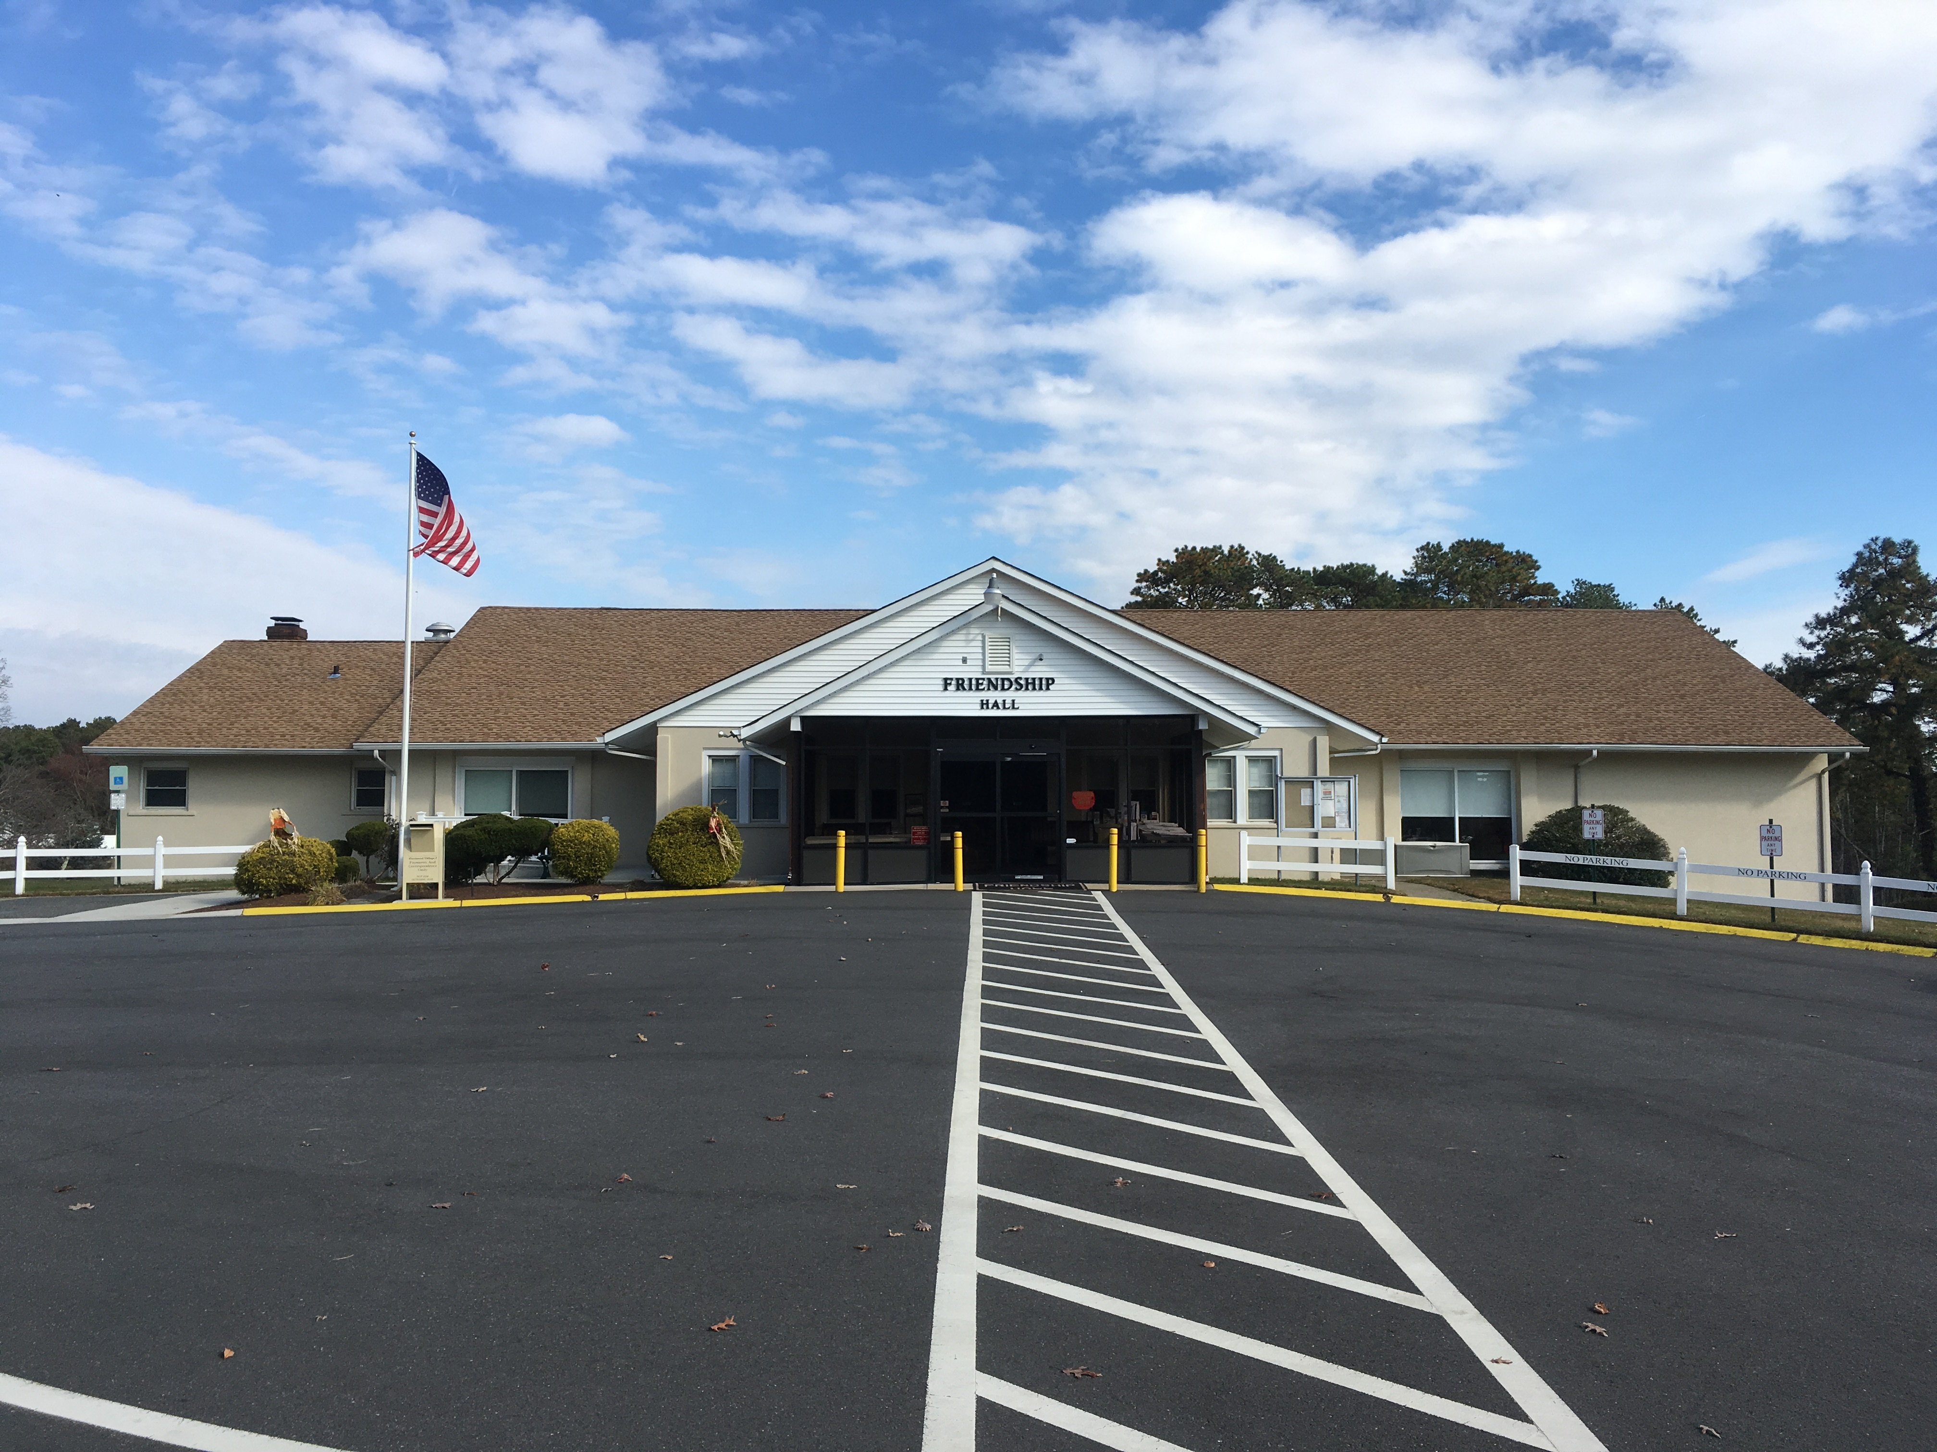
CRESTWOOD
VILLAGE 1
MAJOR CAPITAL RESERVE ITEMS

Slide 2
Introduction & Village Information
Built circa 1965
Approximately 190 acres and 9 miles of roads throughout Village 1
355 buildings and 1,016 units in total
  Quads = 153 buildings
  Duplexes = 161 buildings
  Lakewoods = 82 buildings
  Large Capital Reserve Project Items not covered by monthly Maintenance Fees
    Storm Drains
    Driveways
    Roofs
    Dams
    Crawlspaces

Slide 3
From the time of Village Construction, many building codes have changed; Electrical, Plumbing, Fire Codes, Framing etc.
We have been dealing with these items on a reactionary basis, but now that we are seeing an increase of these items failing and being in need of repairs, we have been discussing how to best implement Proactive Planning for these Major Capital Reserve items not currently covered.
This presentation has been prepared to inform you the residents, of all the additional work needed to keep Crestwood Village a great place to reside.

Slide 4

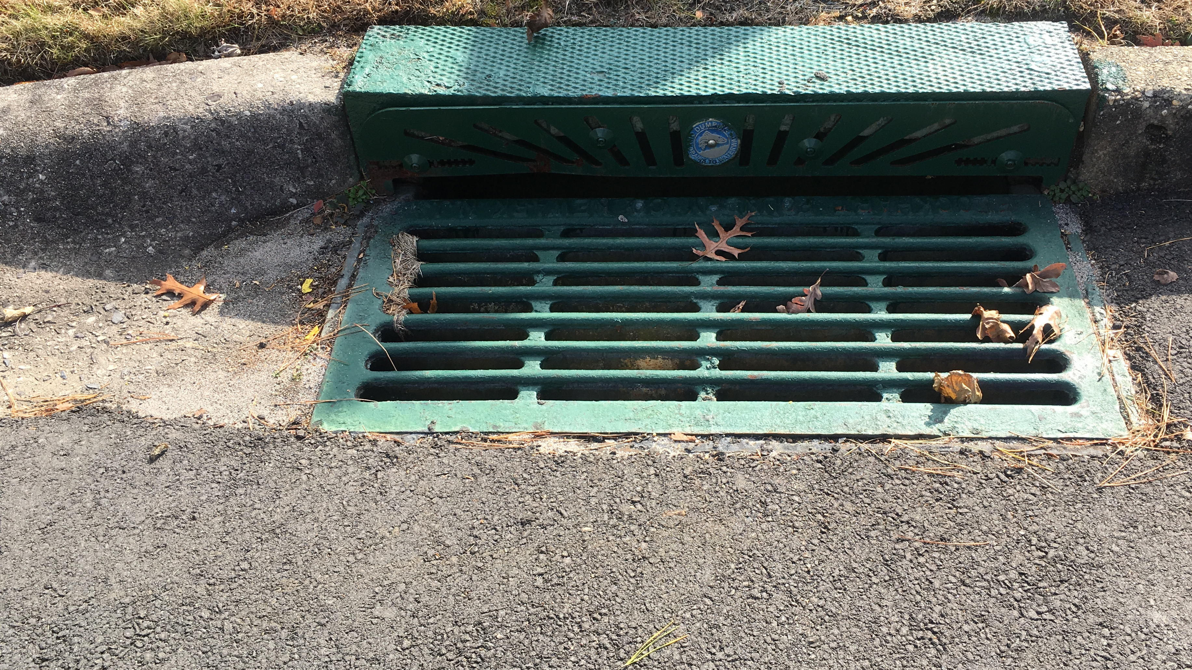



Storm Drains and Village Drainage

Slide 5

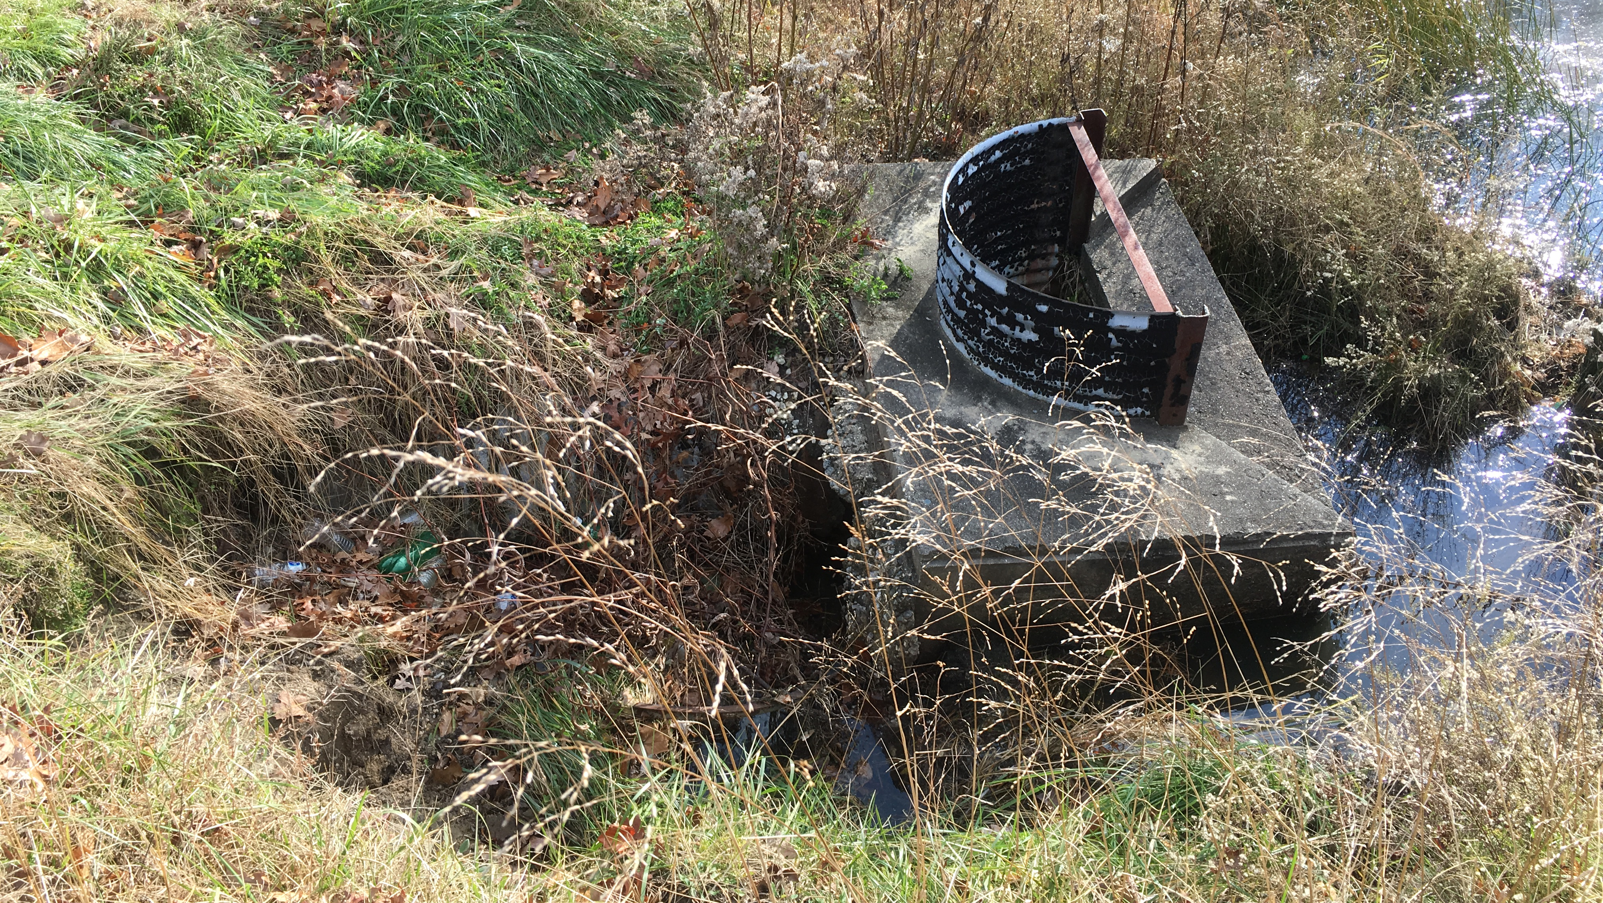
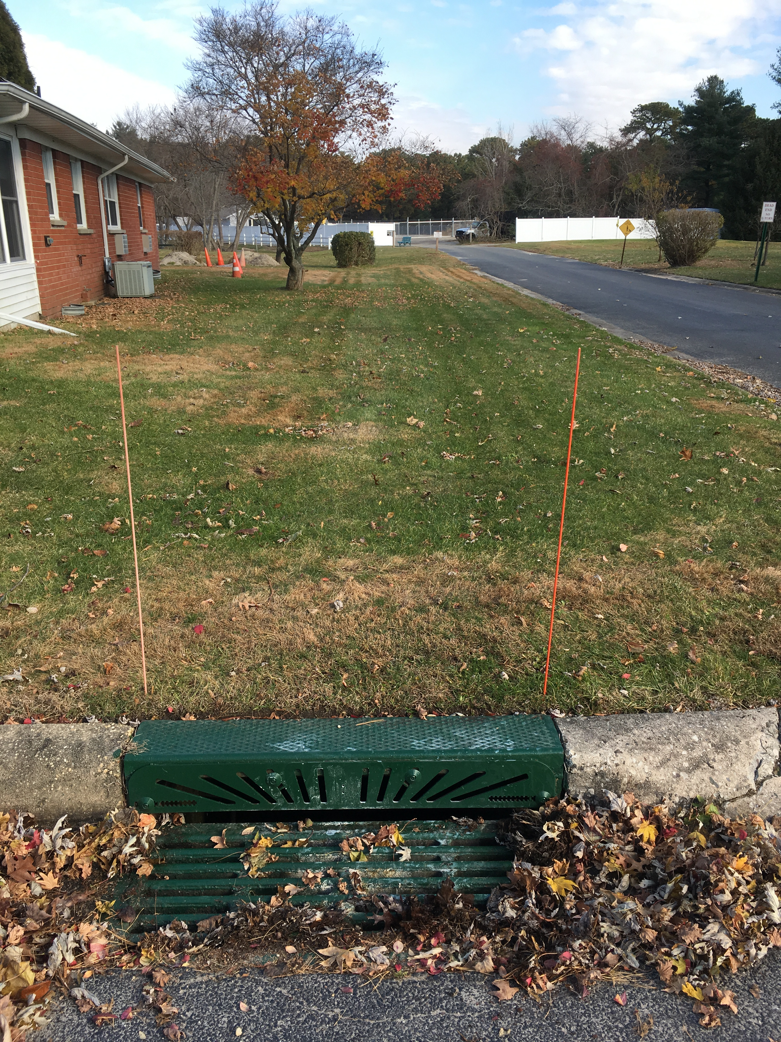
Current Issues
Concrete Drainage Pipes Installed circa 1960
2 Drainage Locations were failing and have been repaired
  Prior to work beginning,
  Between Maintenance Department Building and Shuffleboard Courts (202 linear feet)
  Engineering & Permits = $50,000
  Cost to Repair = $115,500
  Parallel to Washington Avenue (250 linear feet)
  Cost to Repair = $91,950
  TOTAL COST = $257,450

Slide 6
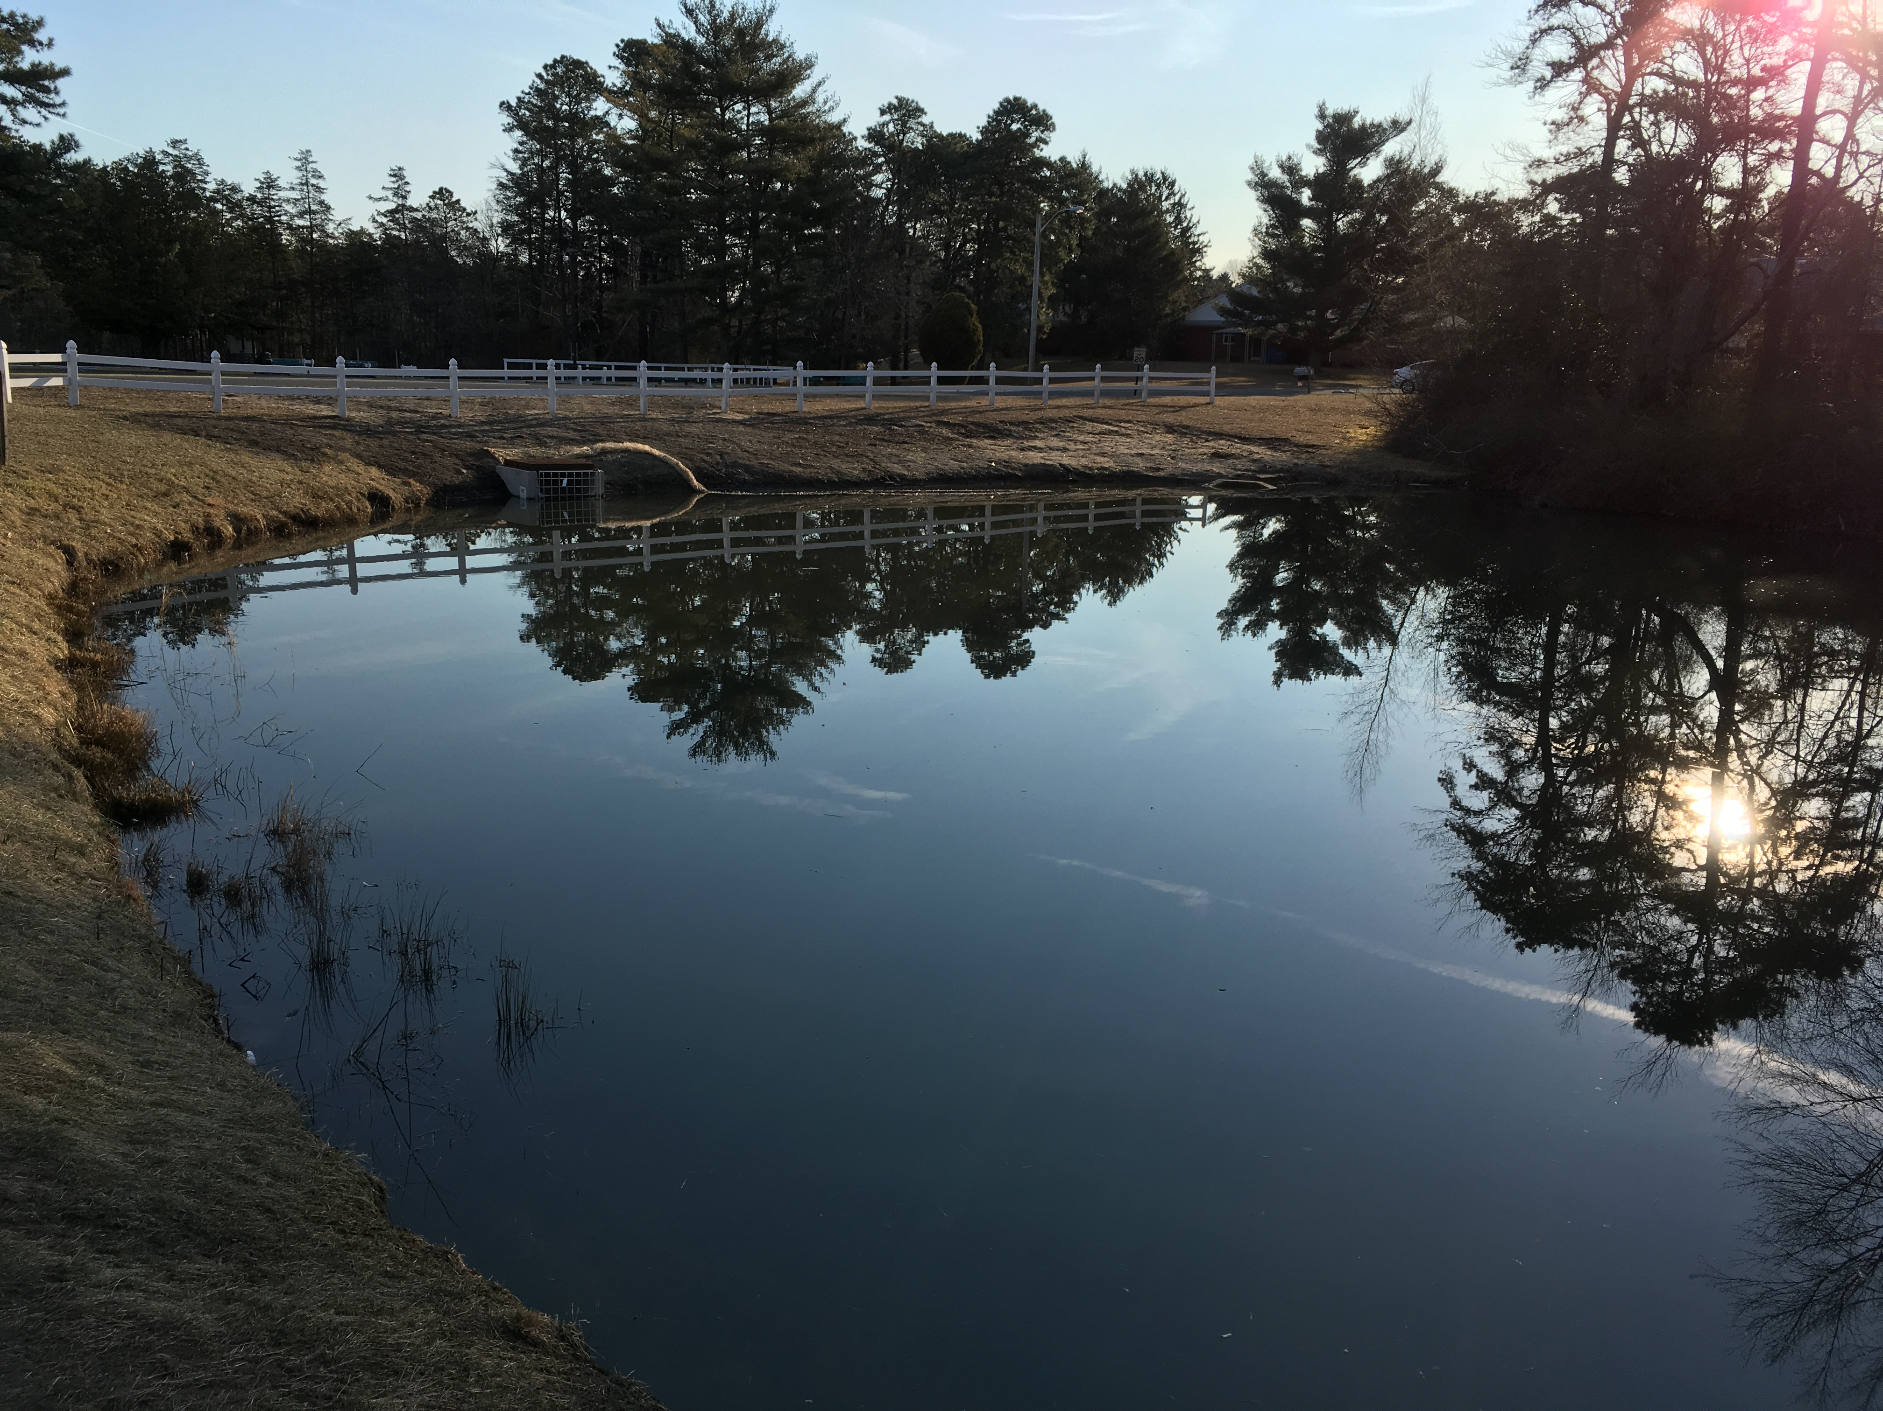
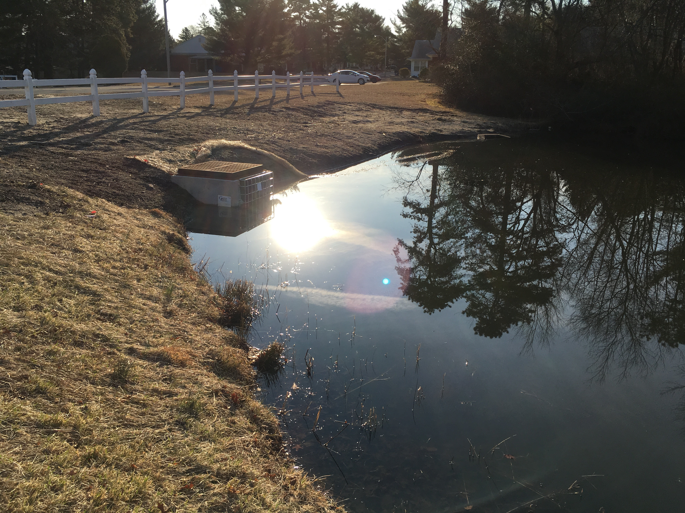
Stormwater Repair Completed

Slide 7
Future Issues
Miles of additional concrete drainage pipes located throughout Village 1.
All existing drainage pipes are original to the 1960 site work completed in Village 1.
Now that we are seeing these storm sewer failures in certain areas and know the relative costs associated with the repairs, we need to anticipate more storm sewer failures in the future.
Currently, with the estimates provided to the Co-op, we are looking at a cost of approximately $370 per linear foot for replacement of storm sewer piping.
Anticipated Cost, potentially millions to repair/replace.
We are looking into getting a camera scope of the existing conditions.

Slide 8
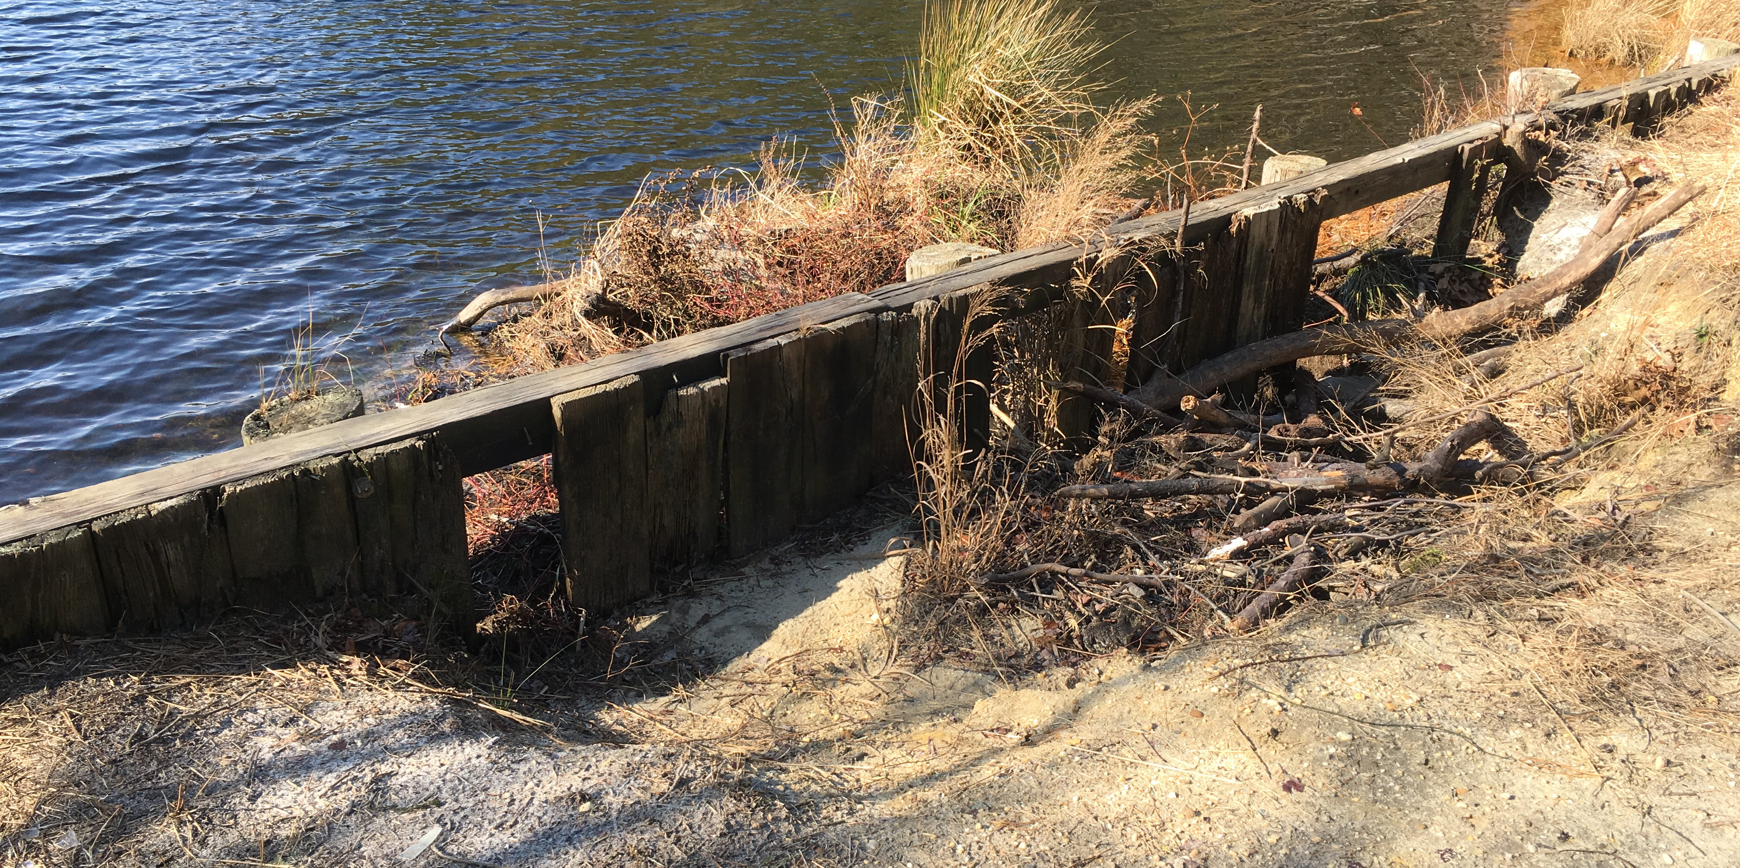
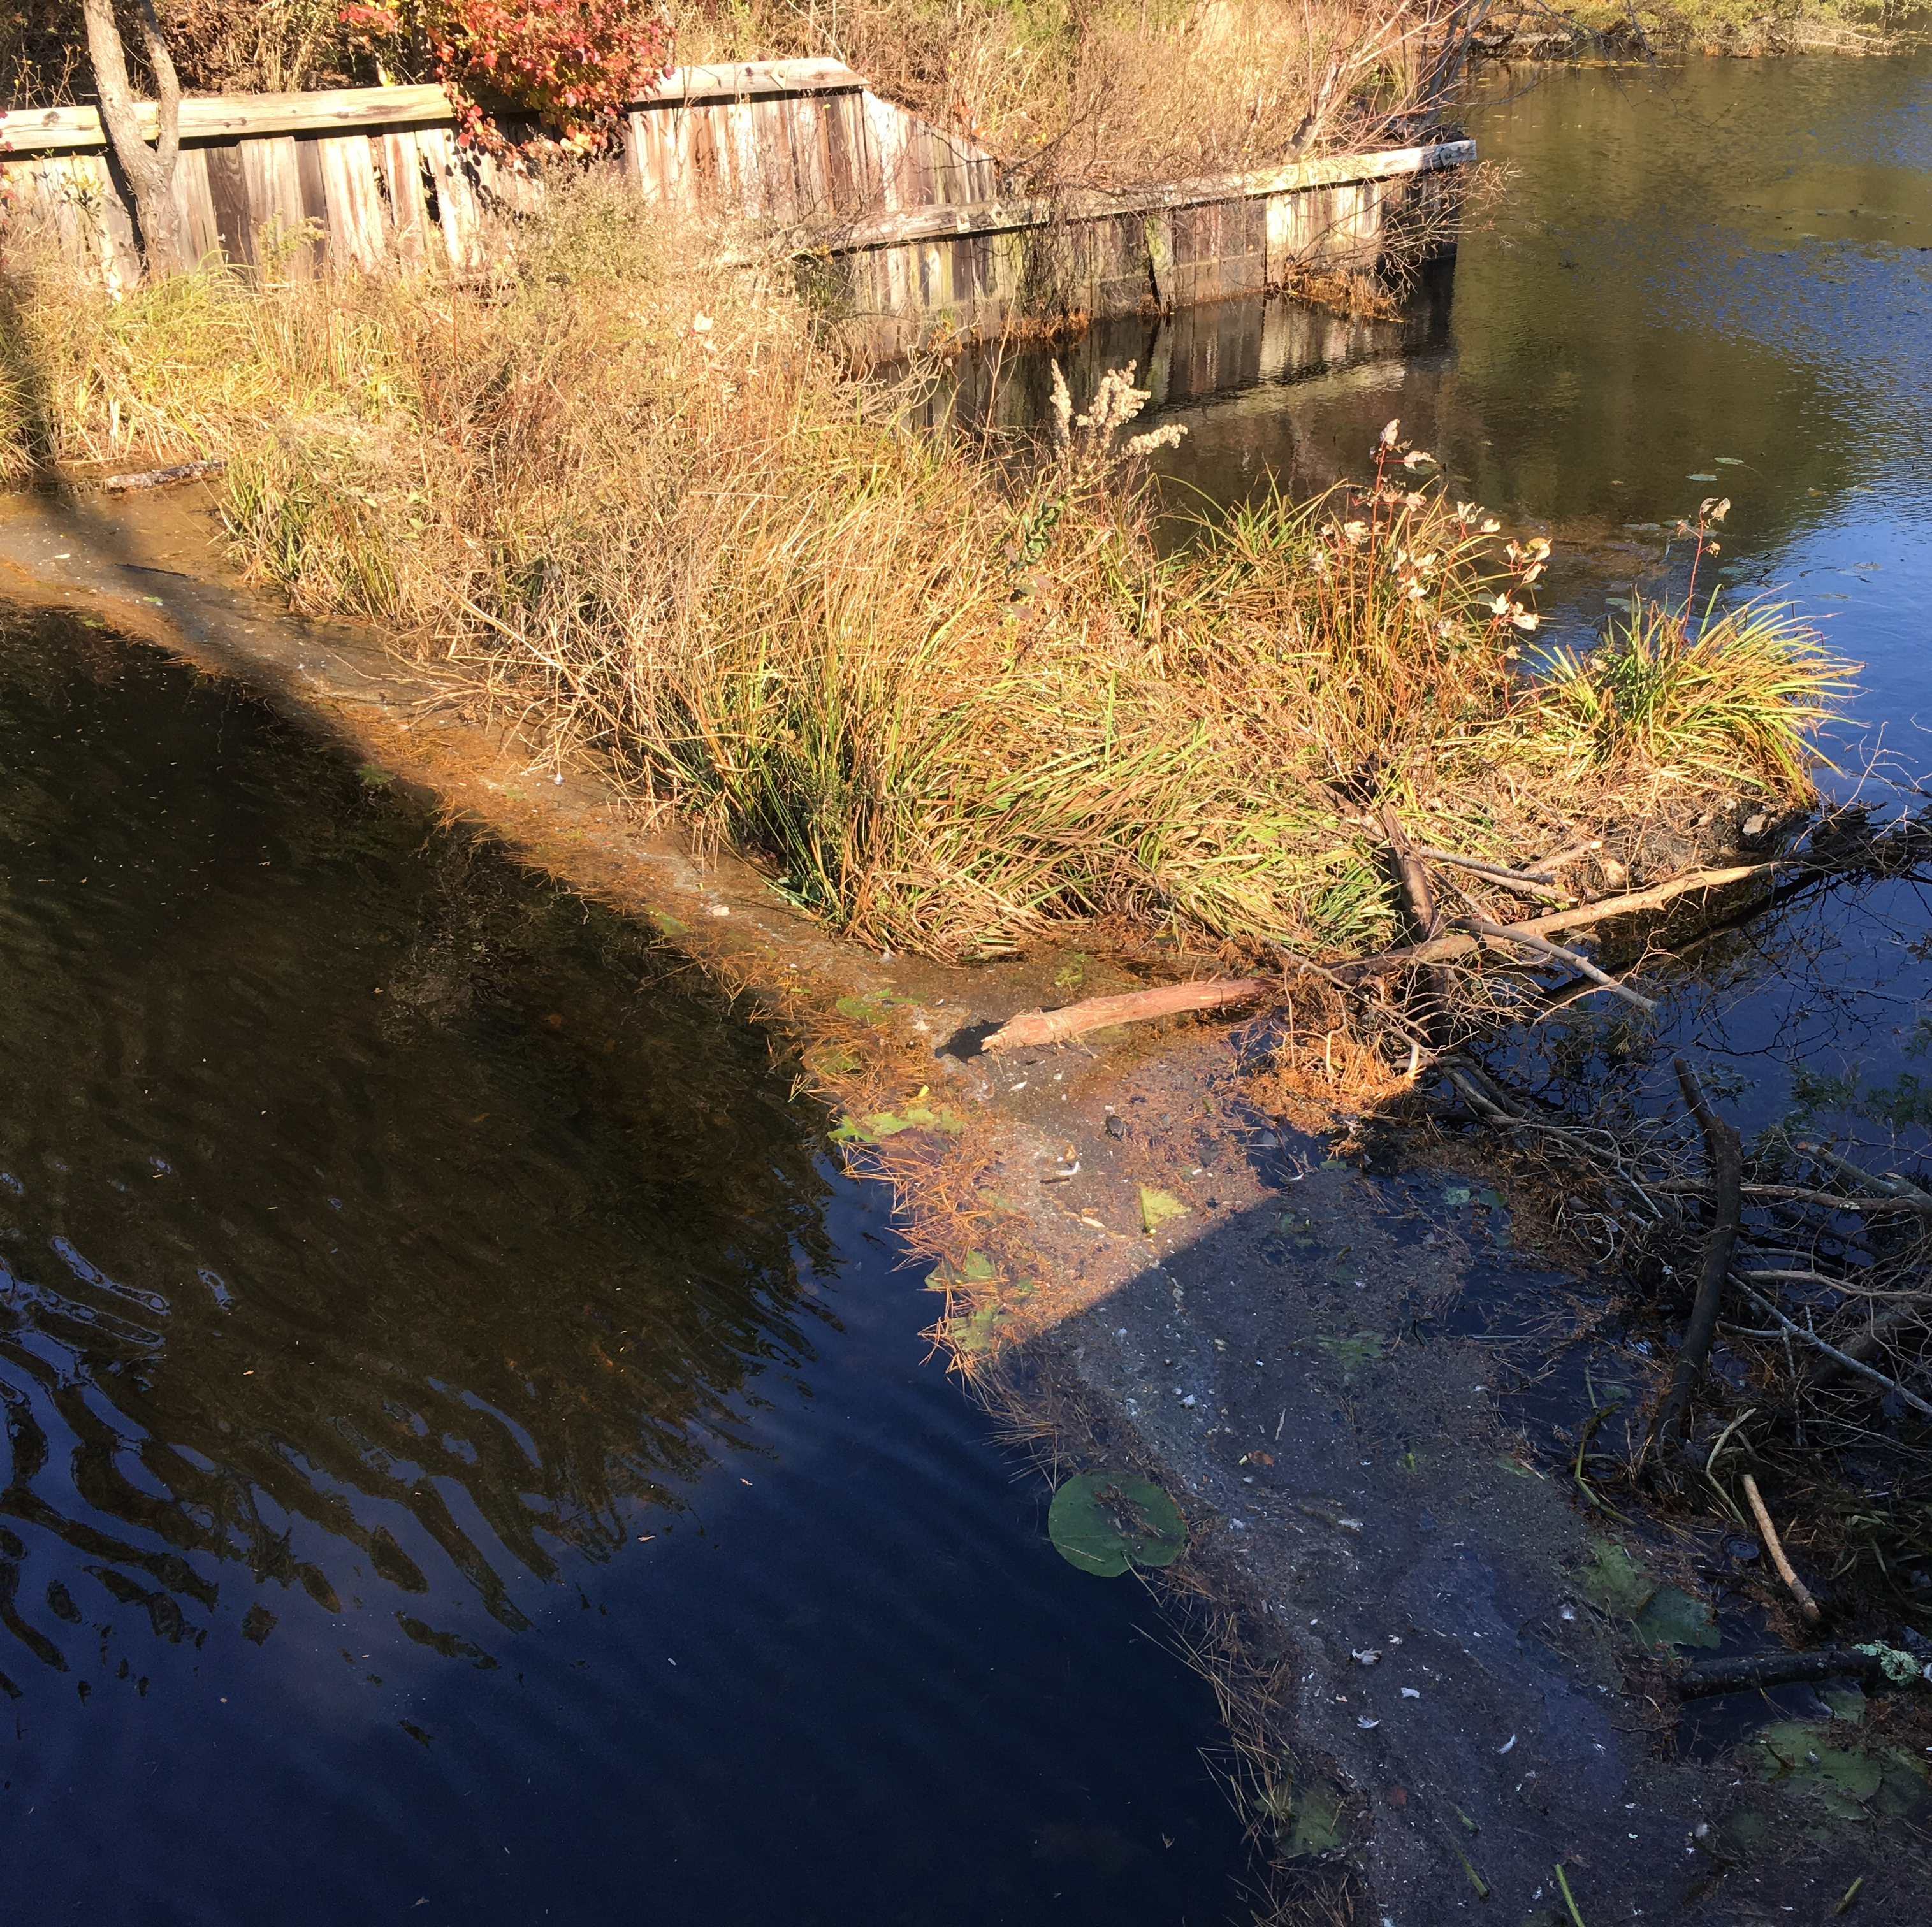
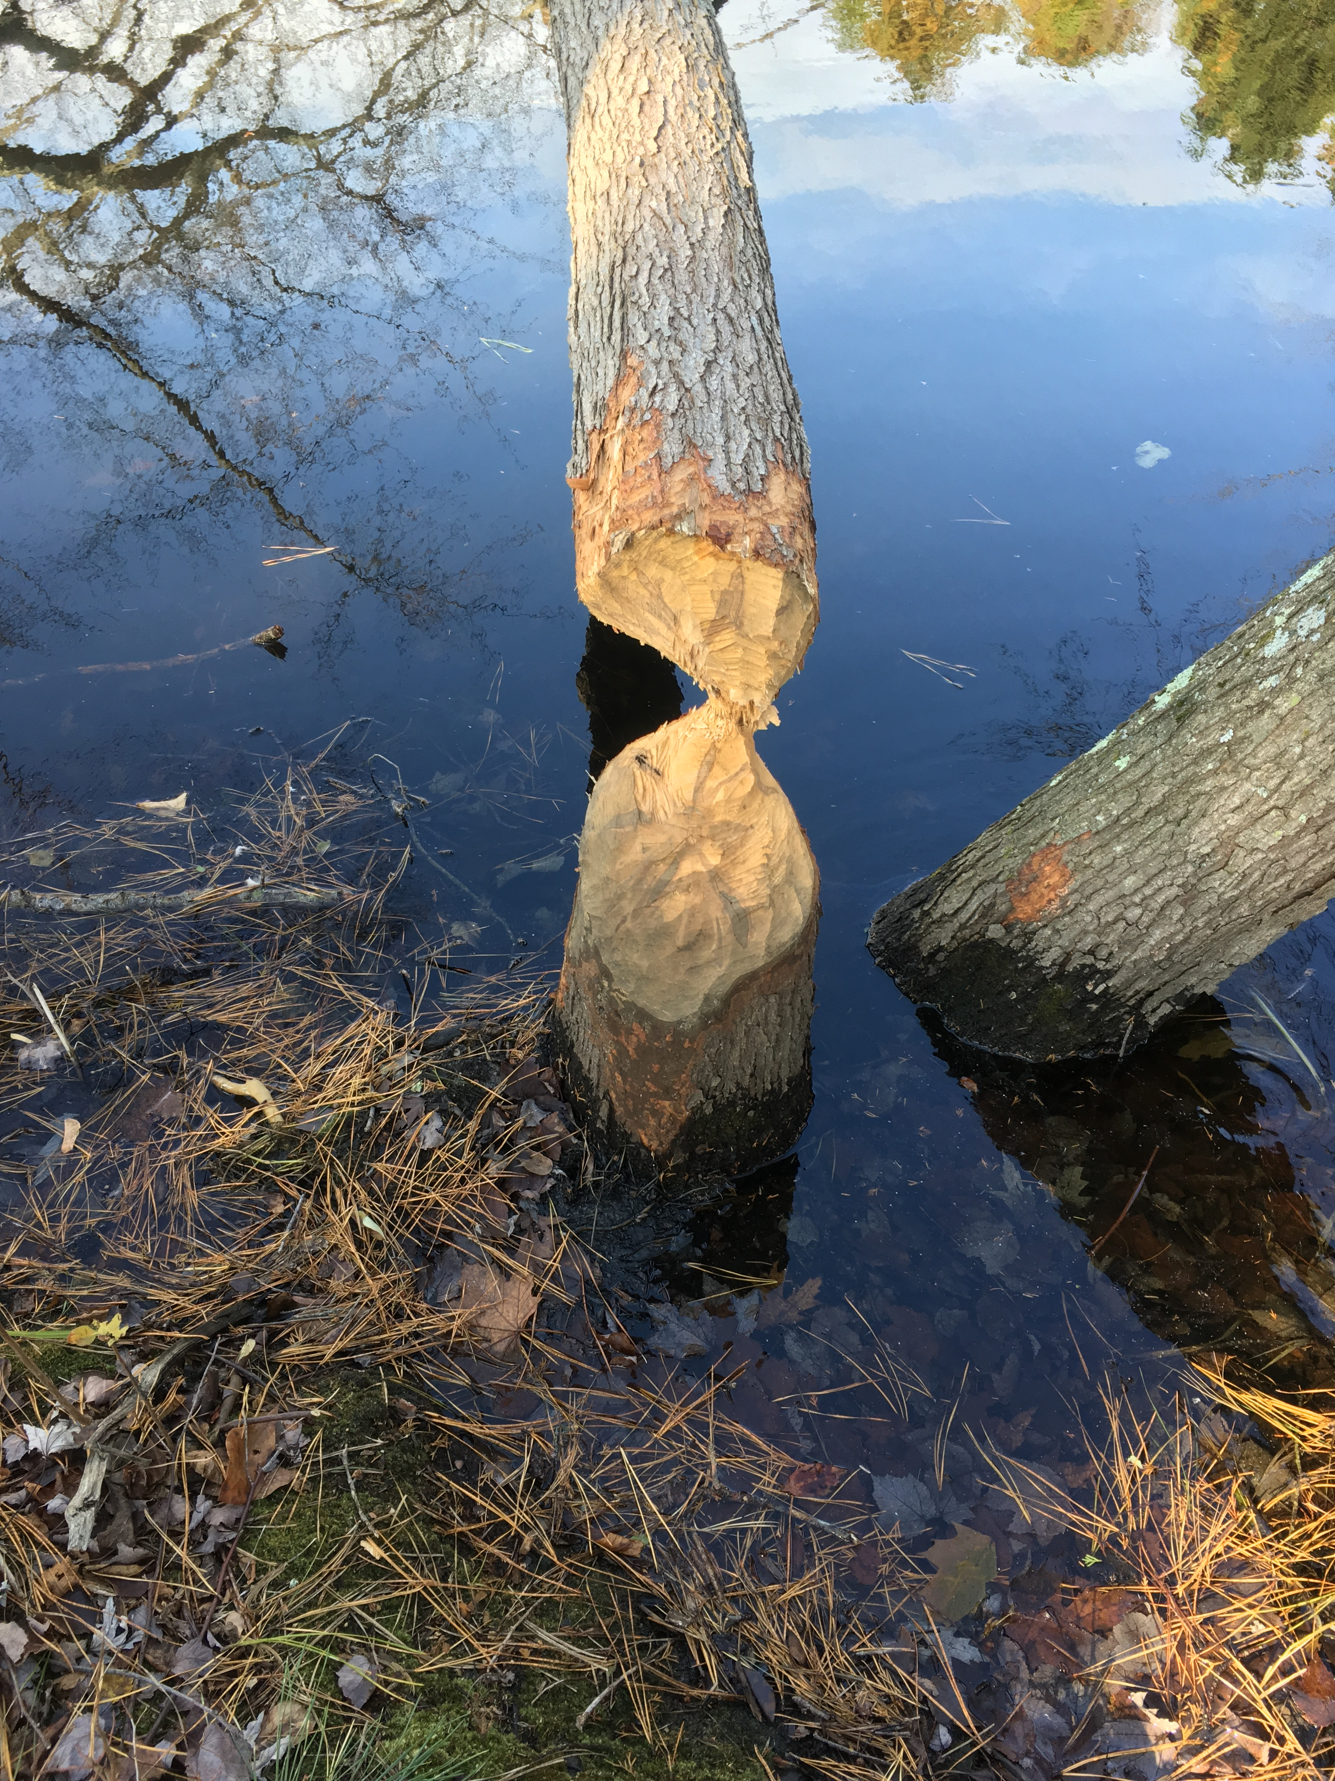
Current Issues
Dams are located in the drainage ponds behind Highland Drive.
First dam is failing and second dam has failed.
Lucky for us, the beavers have thankfully built their own dams in front of this second failed dam.

Slide 9
Future Issues
The drainage ponds add a natural aesthetic to the village, besides offering a place for stormwater to go to.
The dams provide protection from soil erosion and flooding.
If the dams fail completely, we could have a similar situation to that on Schoolhouse Road by the Village 2 entrance. A dry ugly basin that is really an eyesore.
NJDEP and the Pinelands Commission permitting costs would be required, as well as engineering plans and design to meet current stormwater management plans. These ‘soft’ costs will be tens of thousands of dollars.
Total cost for replacement of the dams along Highland is estimated at a minimum of $500,000.

Slide 10
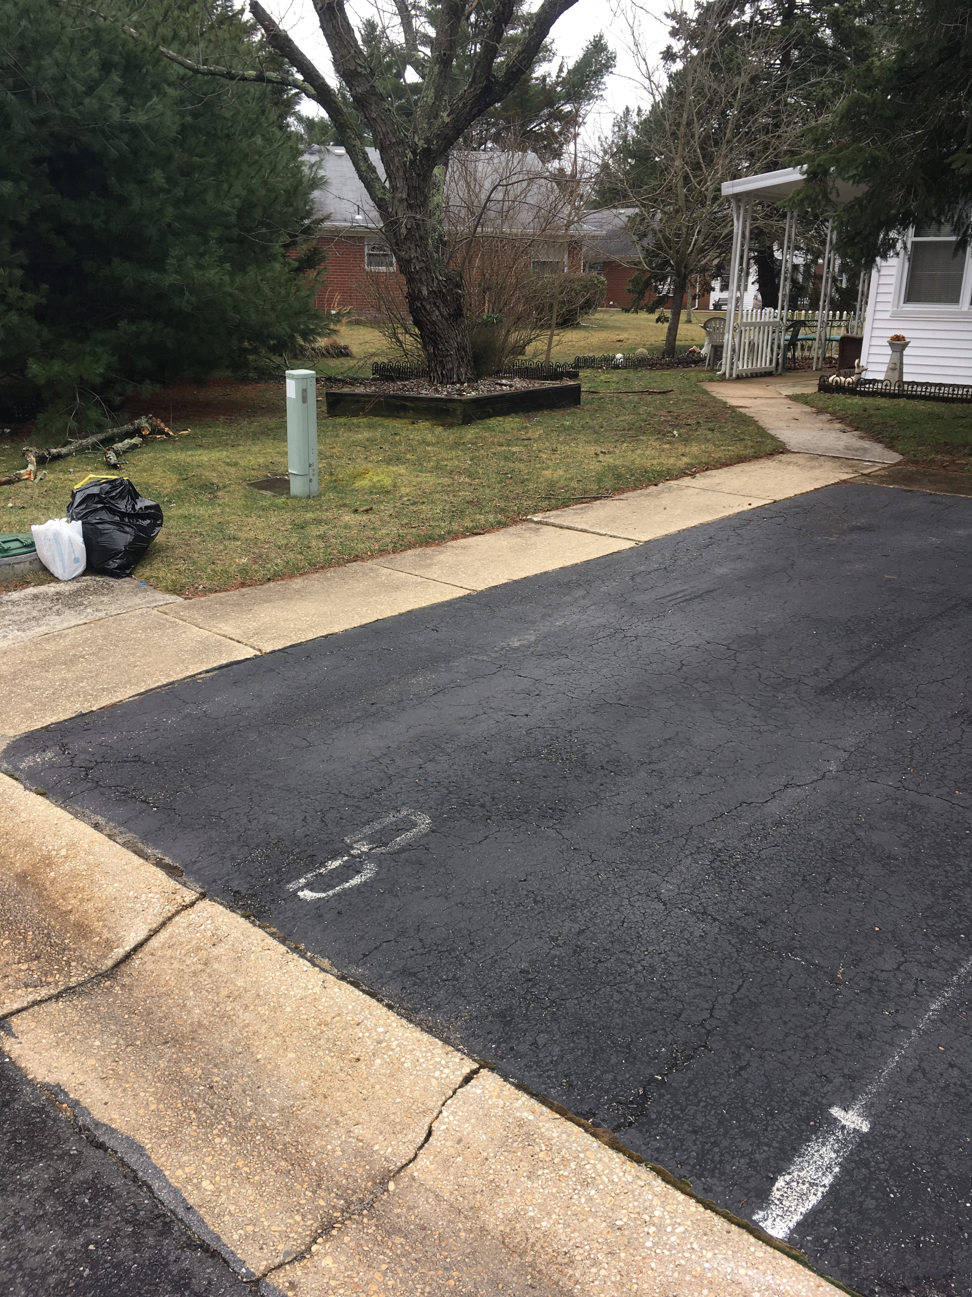
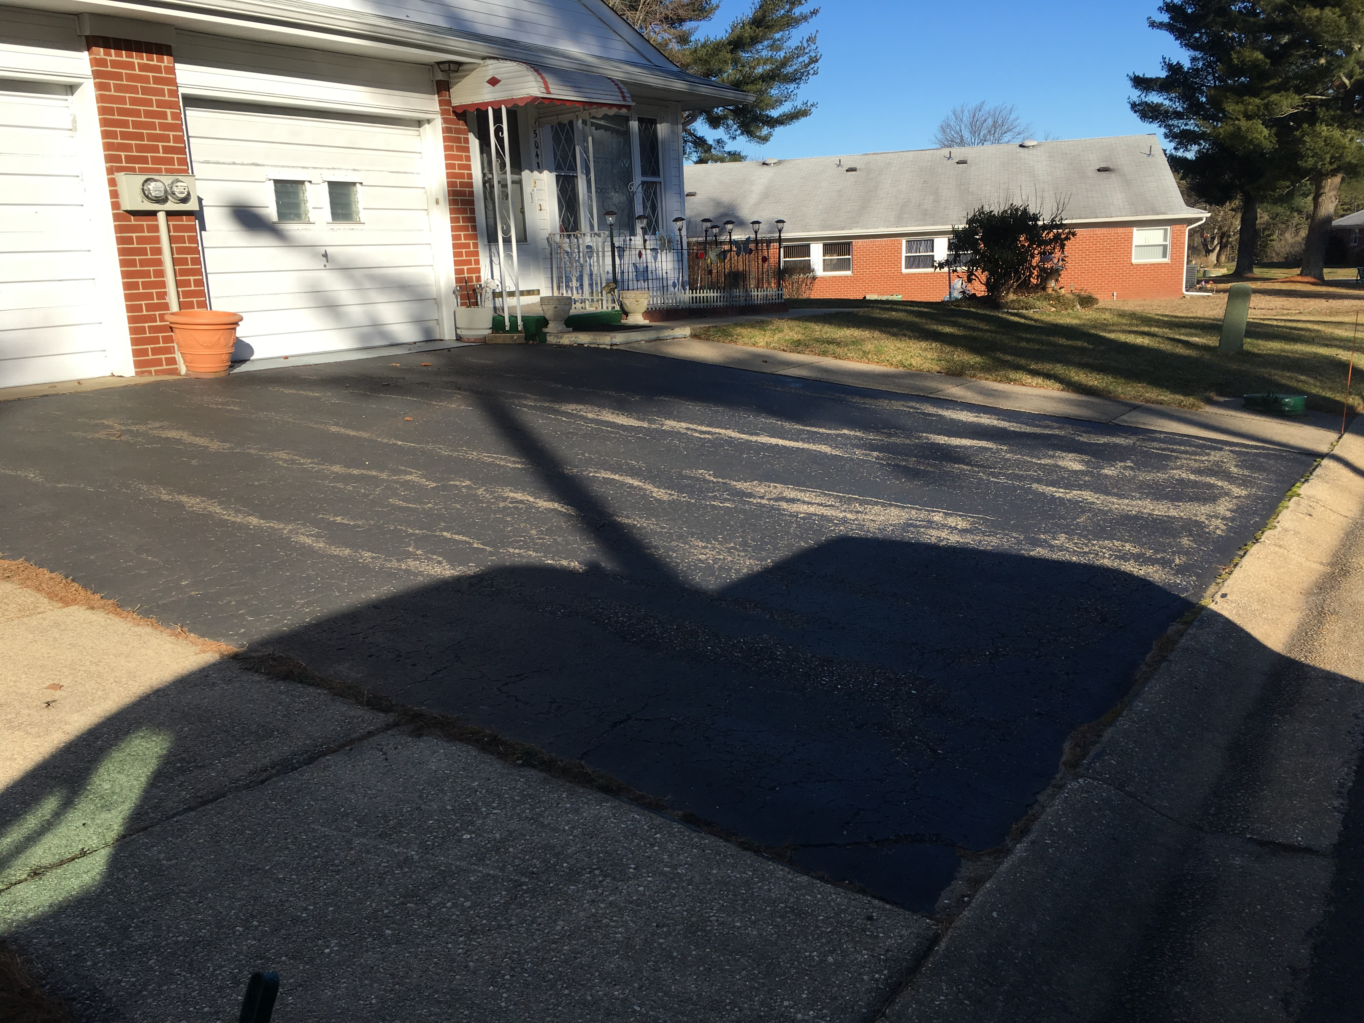
Driveways

Slide 11
Current and Future Issues
Approximately 50% of the buildings throughout Village 1 have had their driveways replaced through 2018.
The current cost to replace a driveway is approximately $4,500 per quad and $2,000 per duplex.
Approximate cost to complete driveway replacements of the remaining 50% of driveways is $500,000.
Also, Village 1 is scheduled for road sealing in the near future. Road Sealcoating is done approx every 7 years as suggested by Village Engineer study. Approximate cost is 100k for each road sealing section. (Village is split into 3 sections)

Slide 12
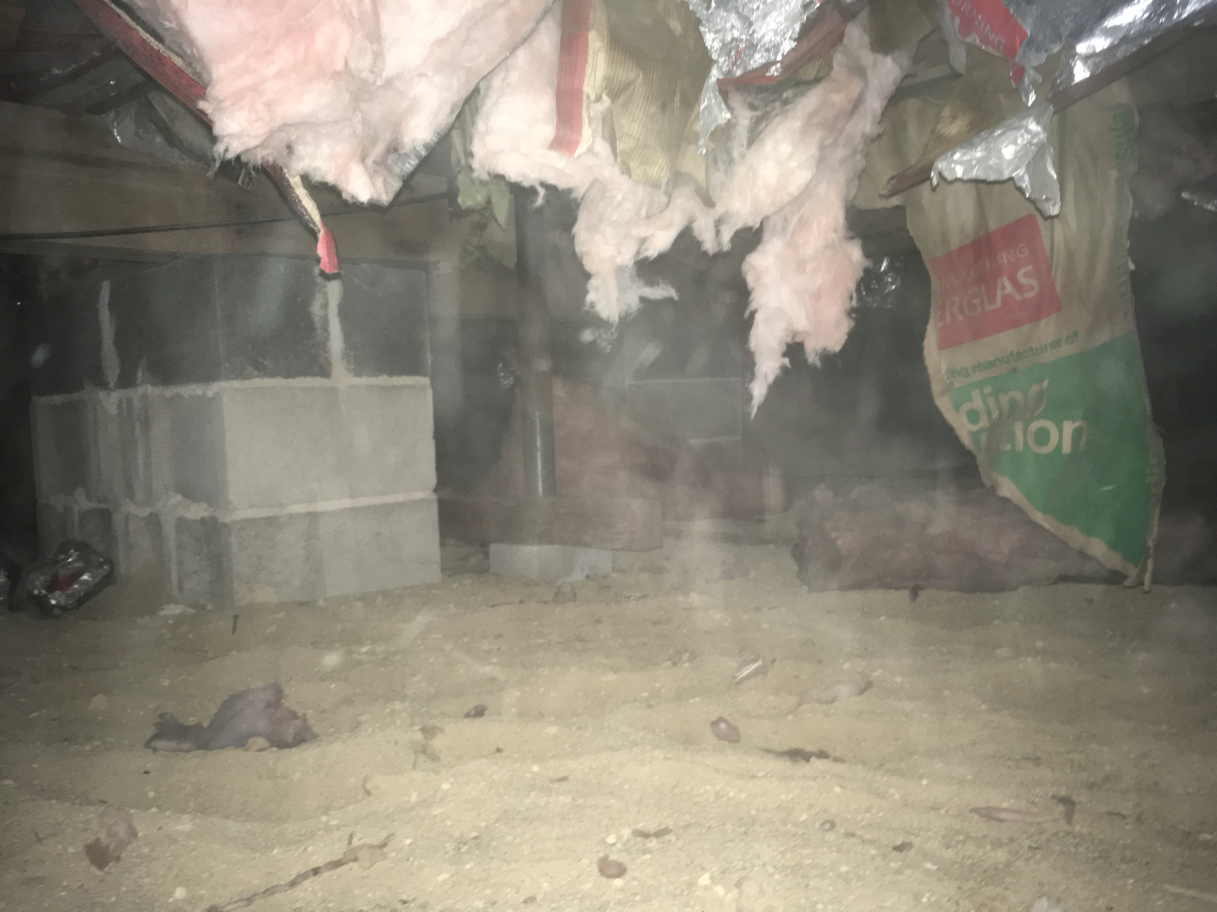
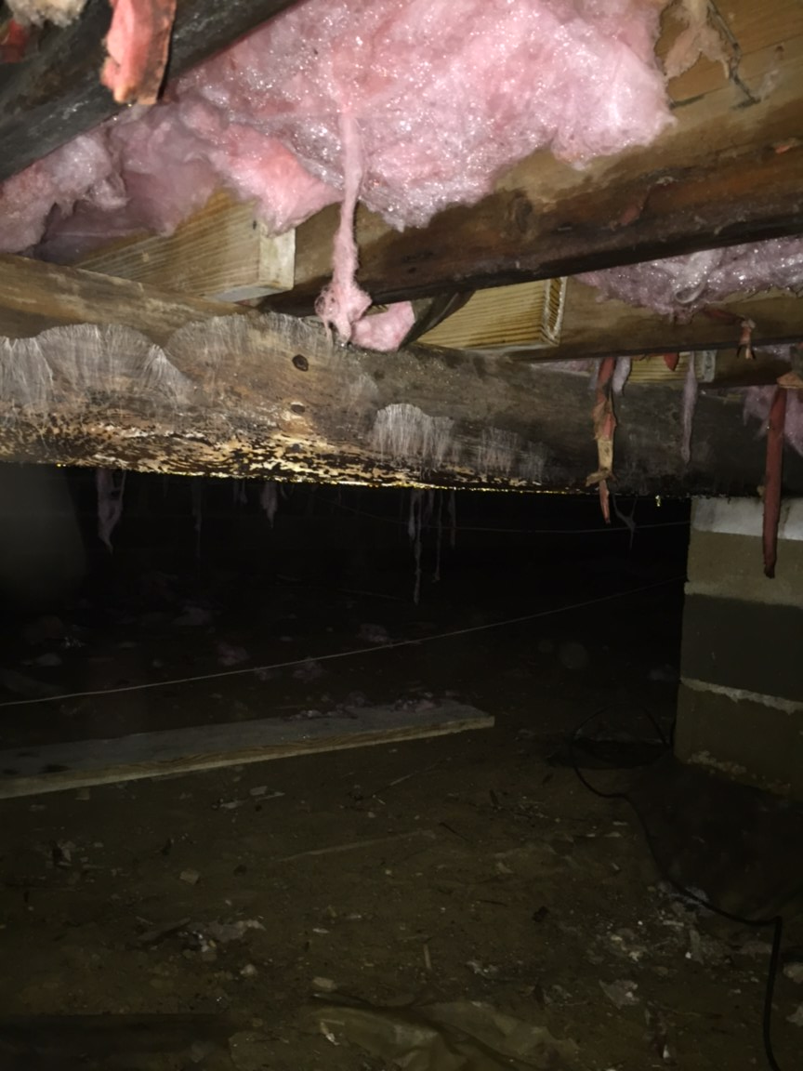
Crawlspaces

Slide 13
Current Issues
Due to the original construction of the buildlings, crawlspaces are a constant source of problems.
Original design of the buildings included:
  Dryer vents exhausting directly into the crawlspace;
  No vapor barriers originally installed over the earthen floors; and
  A Lack of Foundation Waterproofing and Ventilation
  Issues resulting from excess moisture:
  Increased humidity which can lead to wood rot;
  Damaged insulation; and
  Standing Water
Very High Groundwater Tables in some areas exasperates the problem.
Aging Plumbing System is starting to produce lots of failures.

Slide 14
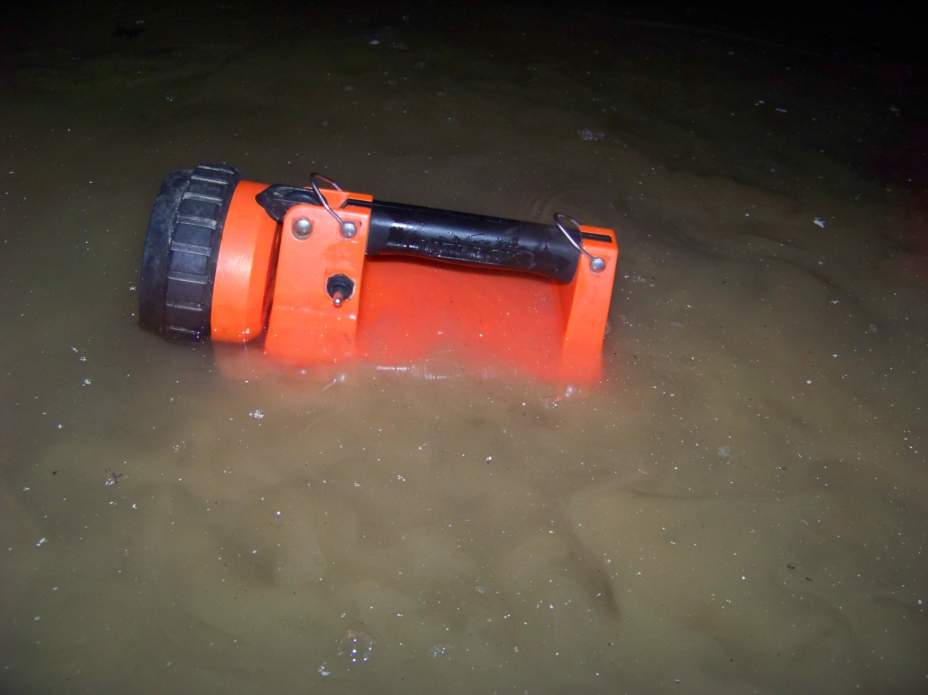
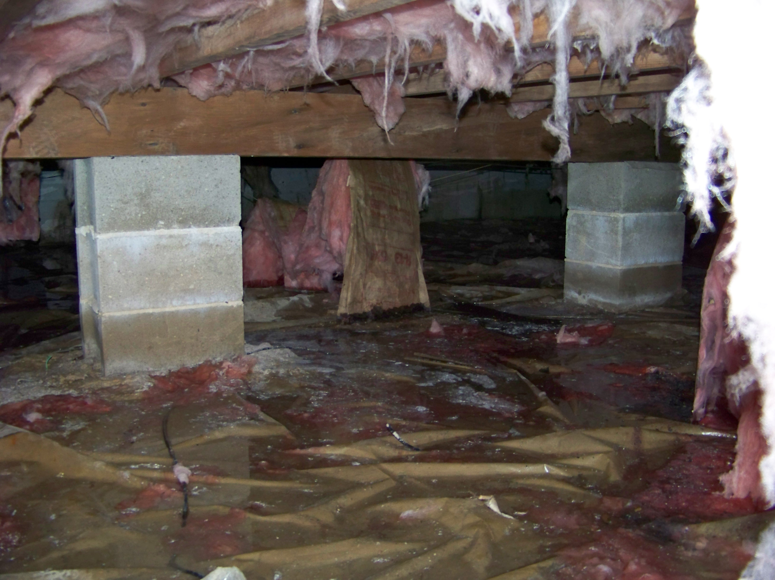
CRAWLSPACE WATER

Slide 15
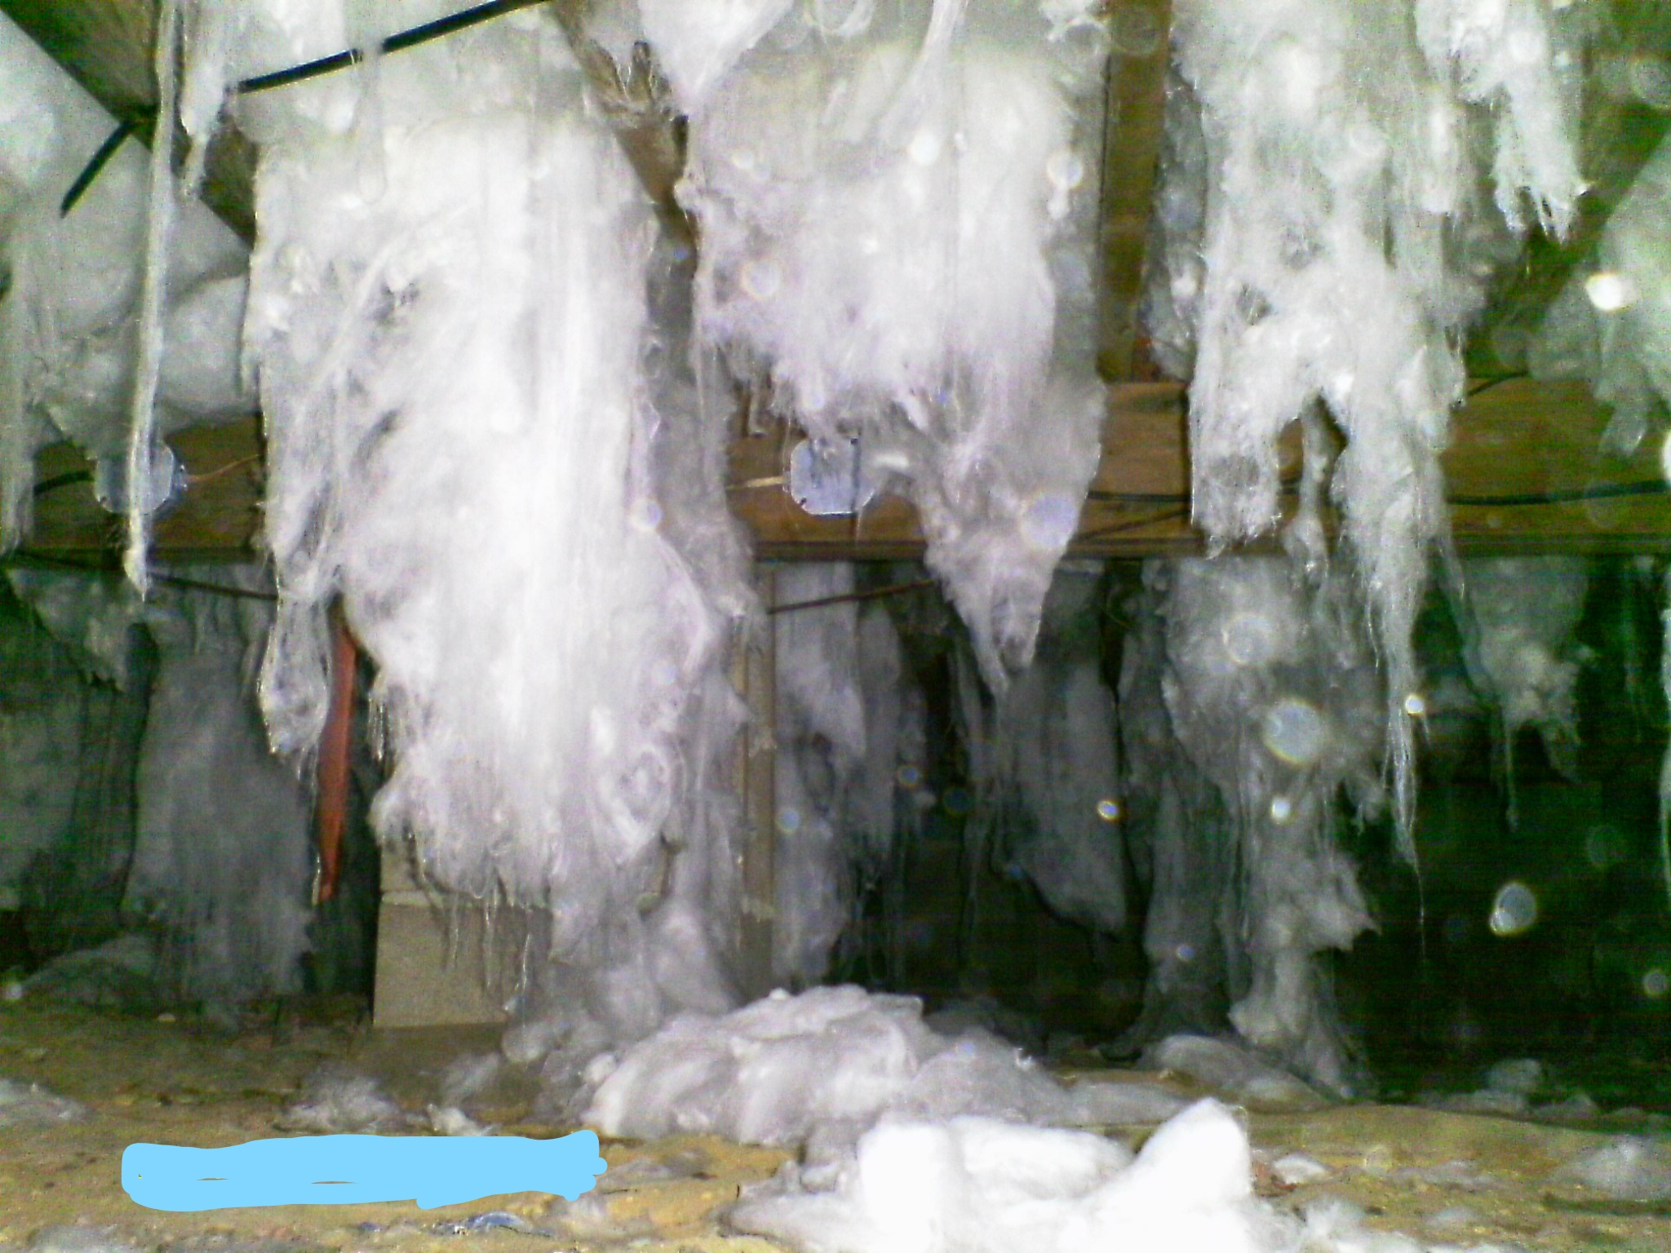
CRAWLSPACE INSULATION DAMAGED FROM EXCESSIVE MOISTURE

Slide 16
A total of 252 units have had their dryer vents corrected to exhaust to the exterior of the building.
  Spent to date approximately = $250,000
For crawlspaces with major moisture issues, Village 1 has been installing crawlspace encapsulation systems.
  Dryers Vented
  All Wood framing is cleaned and disinfected
  All crawlspace vents and a hatch are sealed
  Dehumidifiers and Sump Pumps are installed as needed
  The crawlspace is now a conditioned, treated area with no limited impacts from exterior conditions.

Slide 17
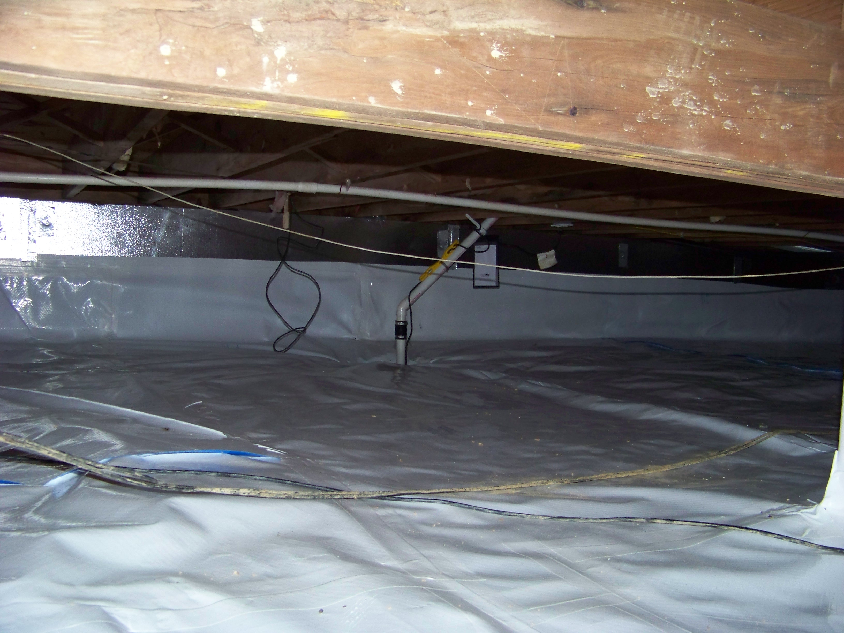
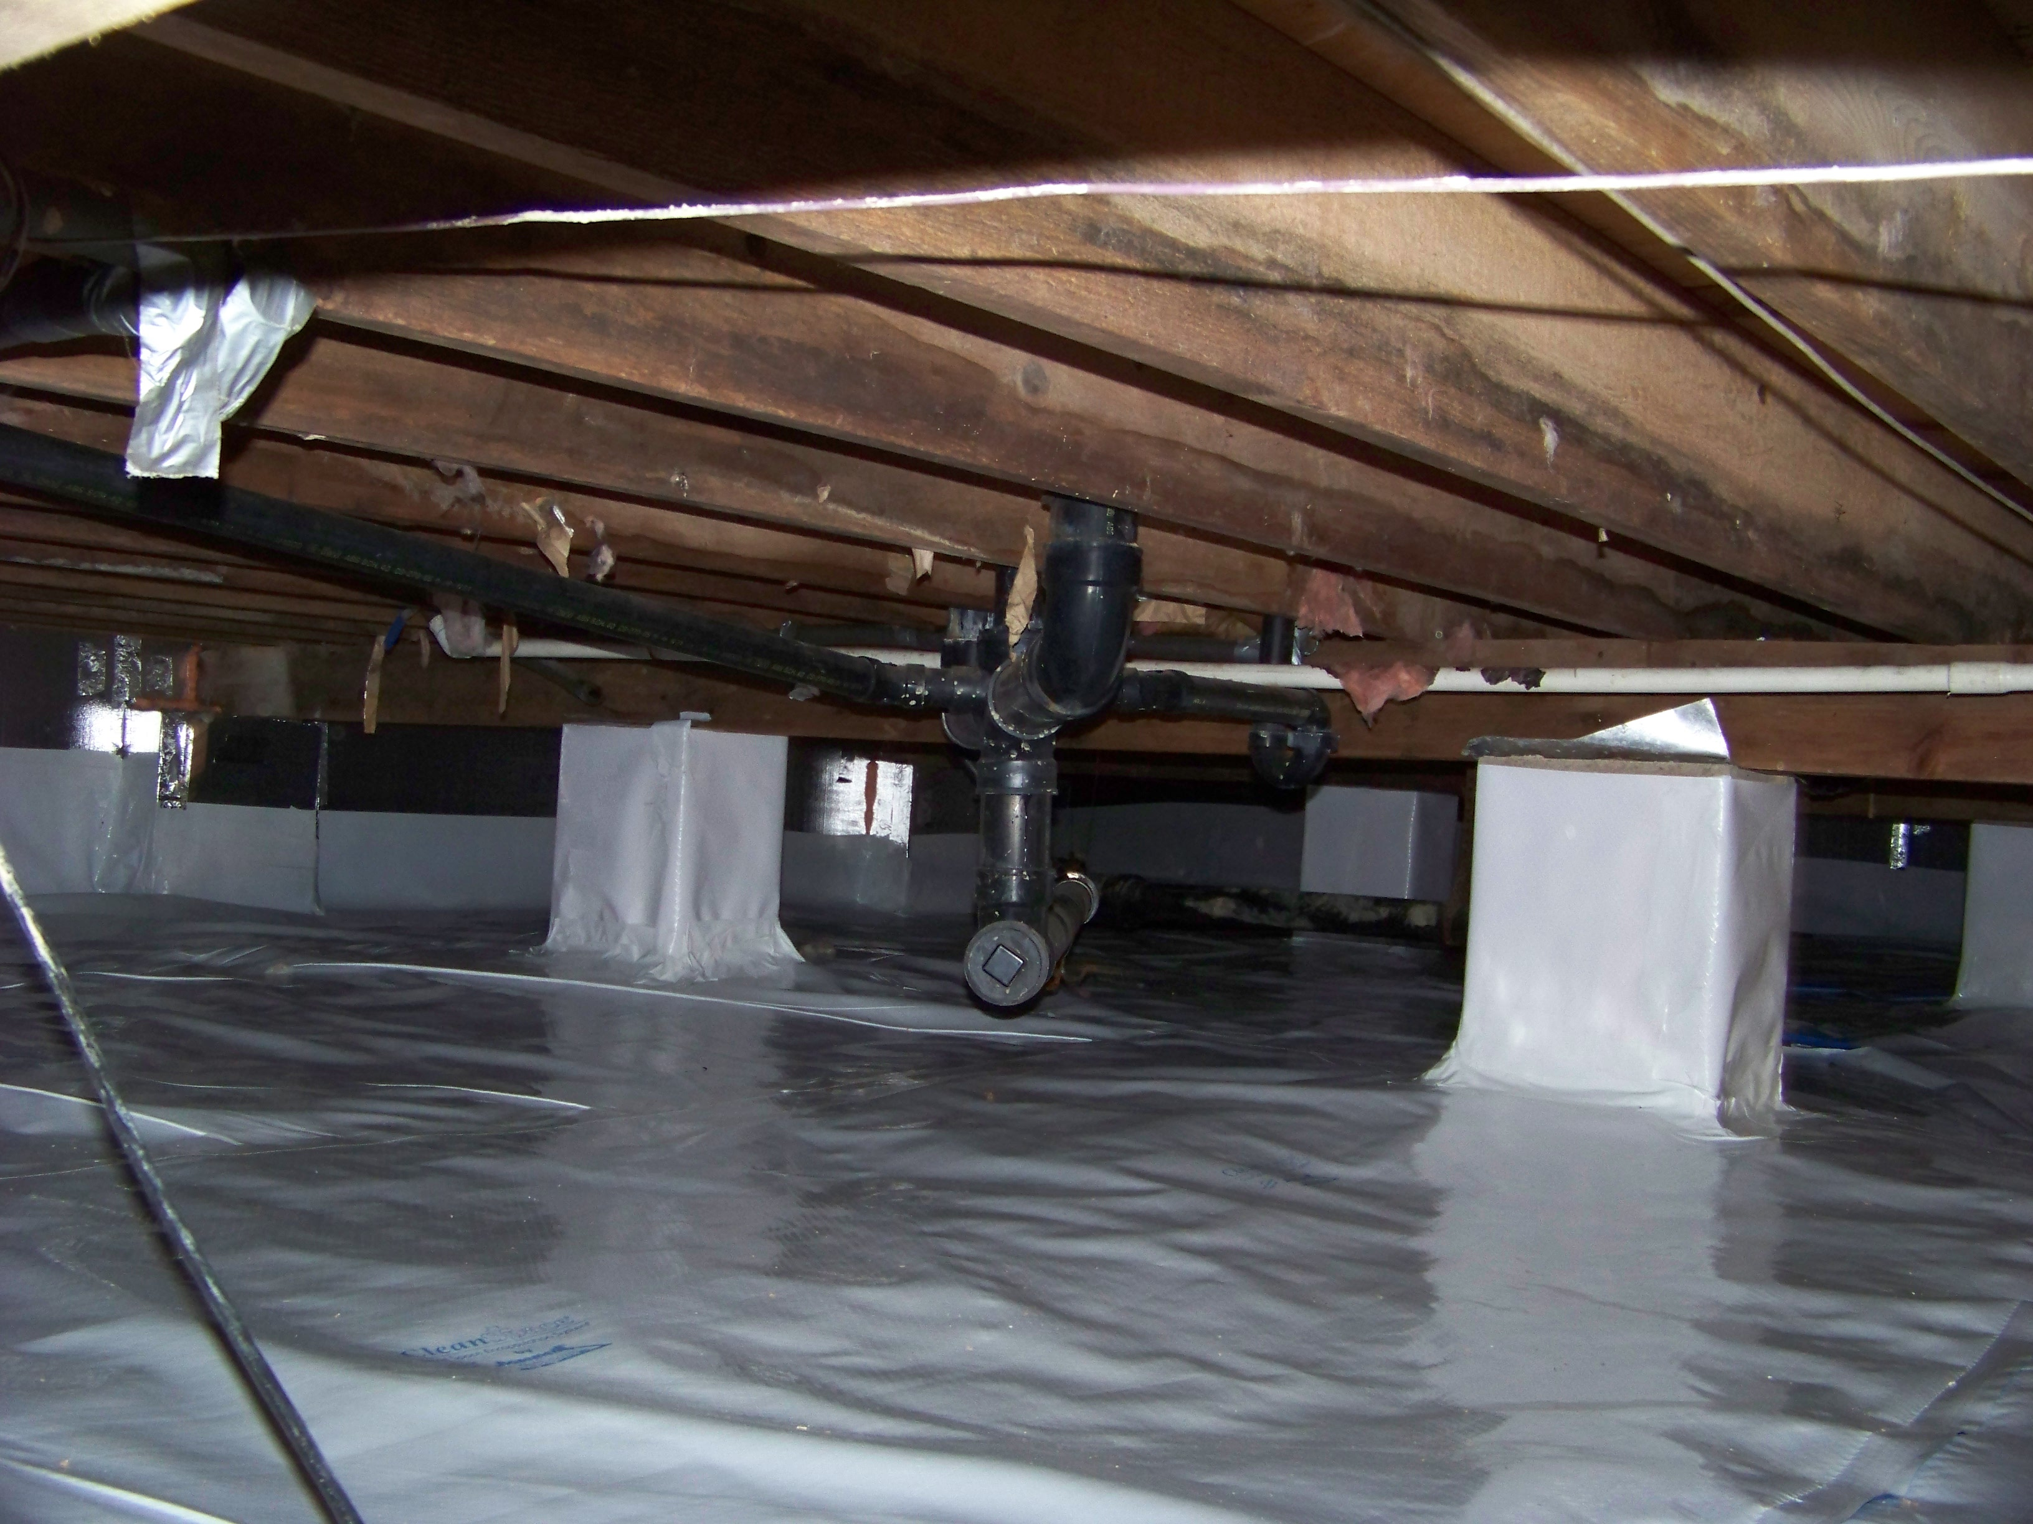
ENCAPSULATION SYSTEM

Slide 18
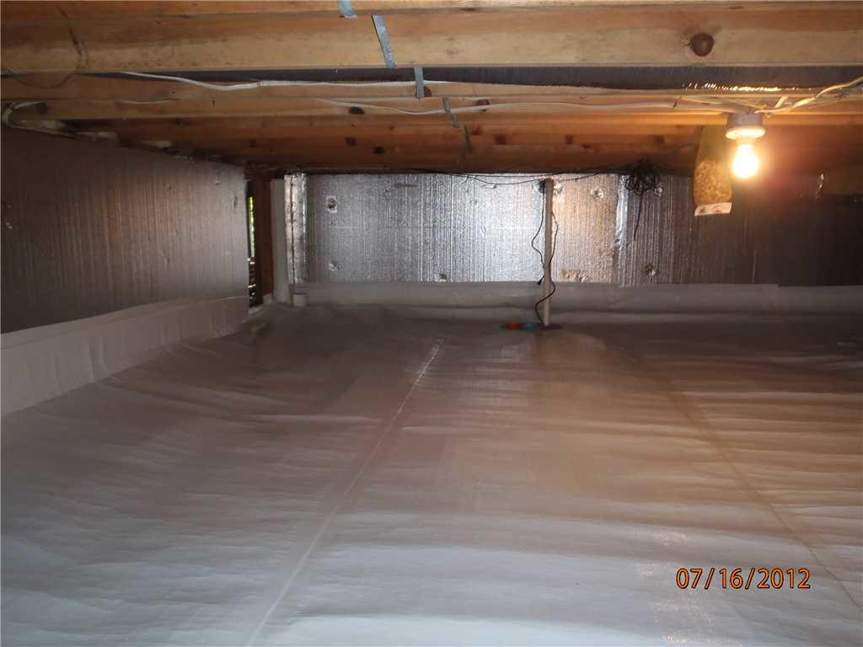
Each system is designed specifically for the building, depending on the conditions.
Sometimes sump pumps are required to remove standing water
Dehumidifiers are required in some instances
Cost of these systems can range from 10-30k per building
Approximately 25 buildings have been encapsulated to date.
Approximately 450k on encapsulation work

Slide 19
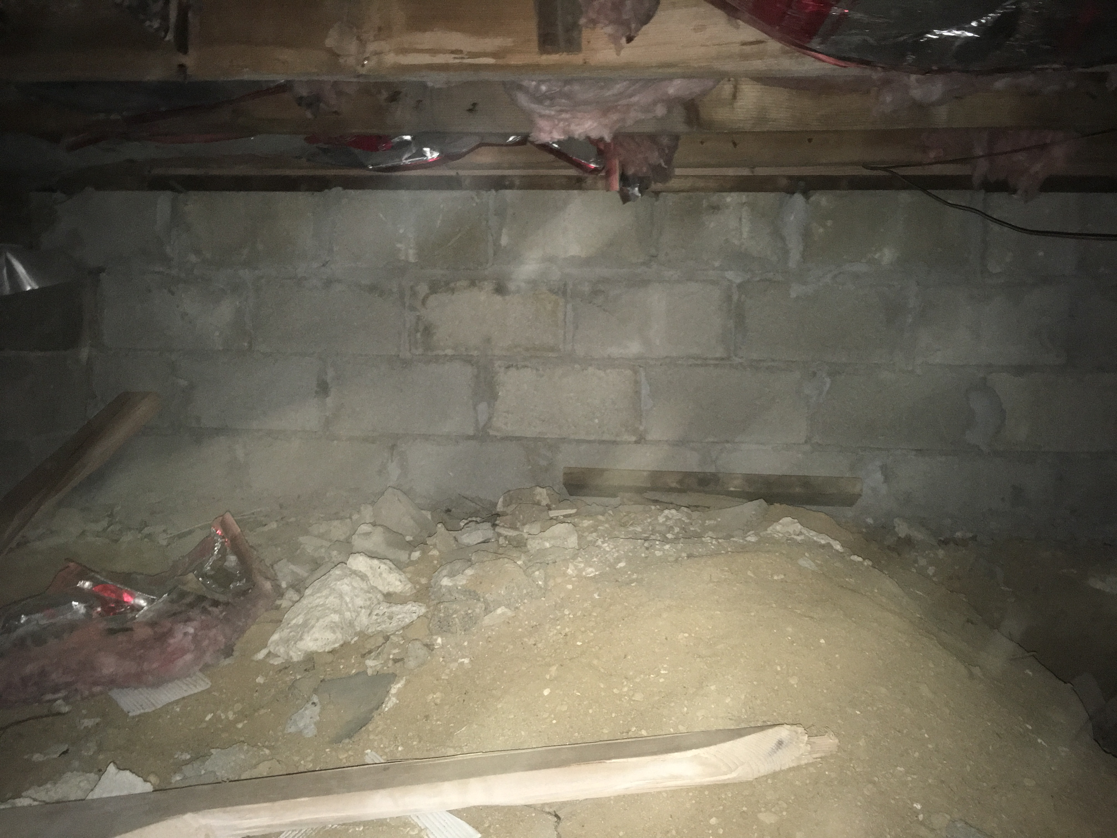
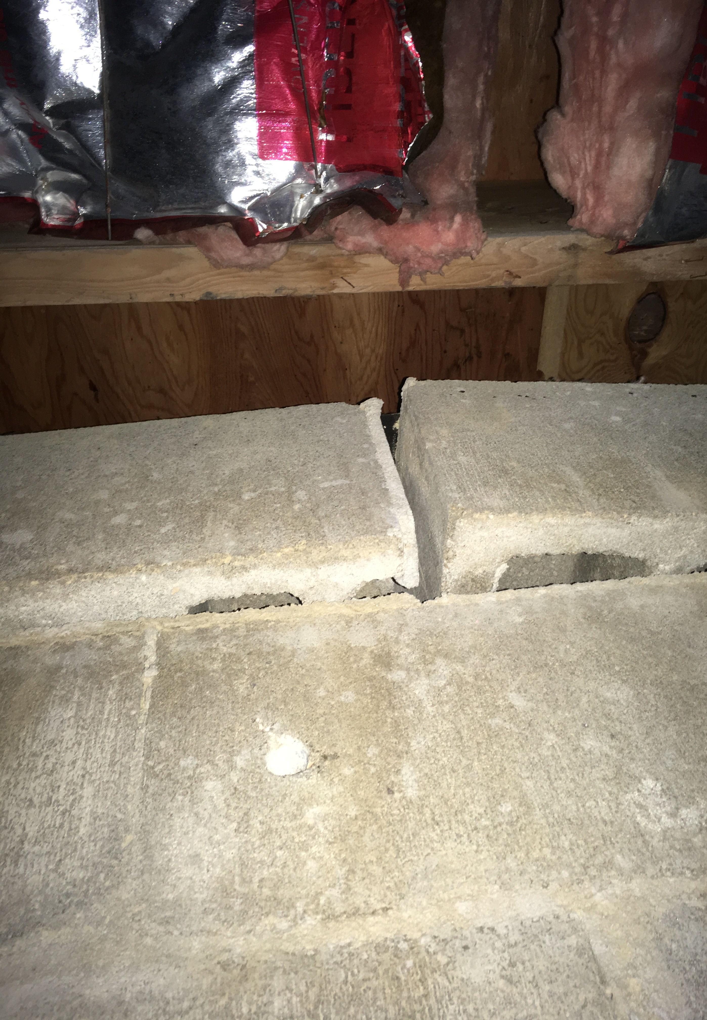
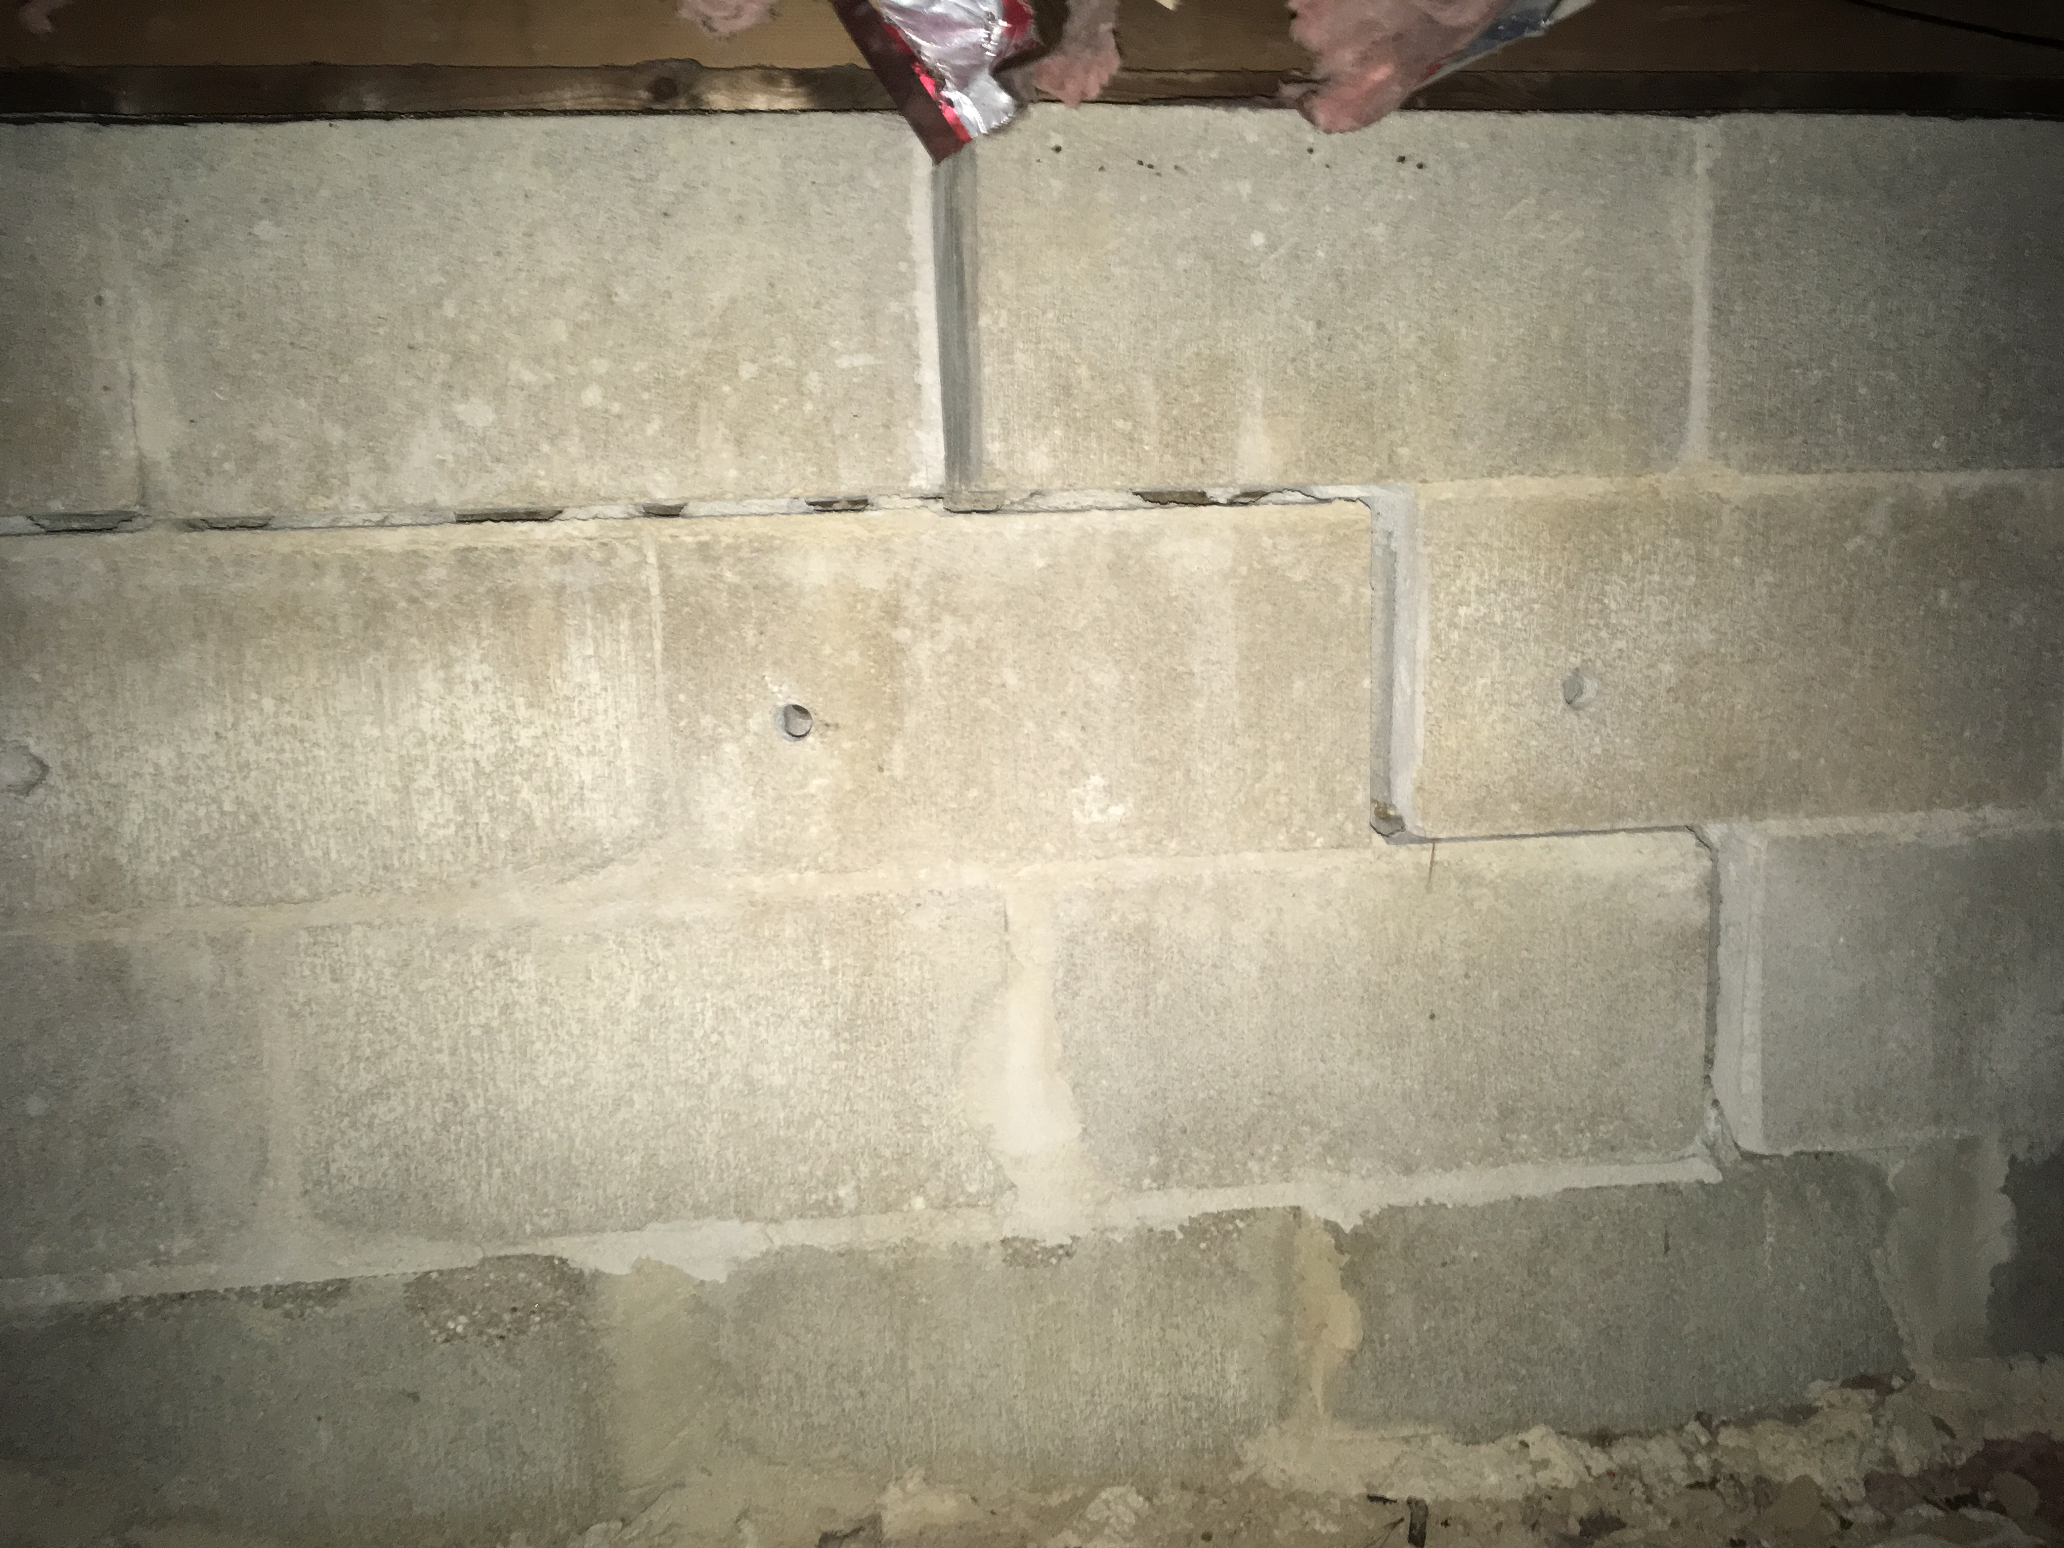
Foundation Issues
A major foundation was addressed recently, identified from a home inspection report. Total cost for this repair was approximately $15,000.
‘After’

Slide 20
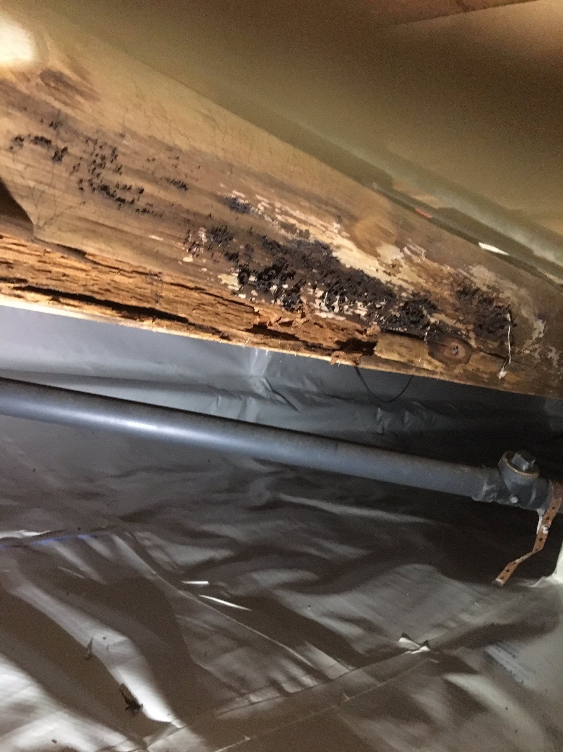
Other crawlspace issues: Aging Plumbing and Framing Systems

Slide 21
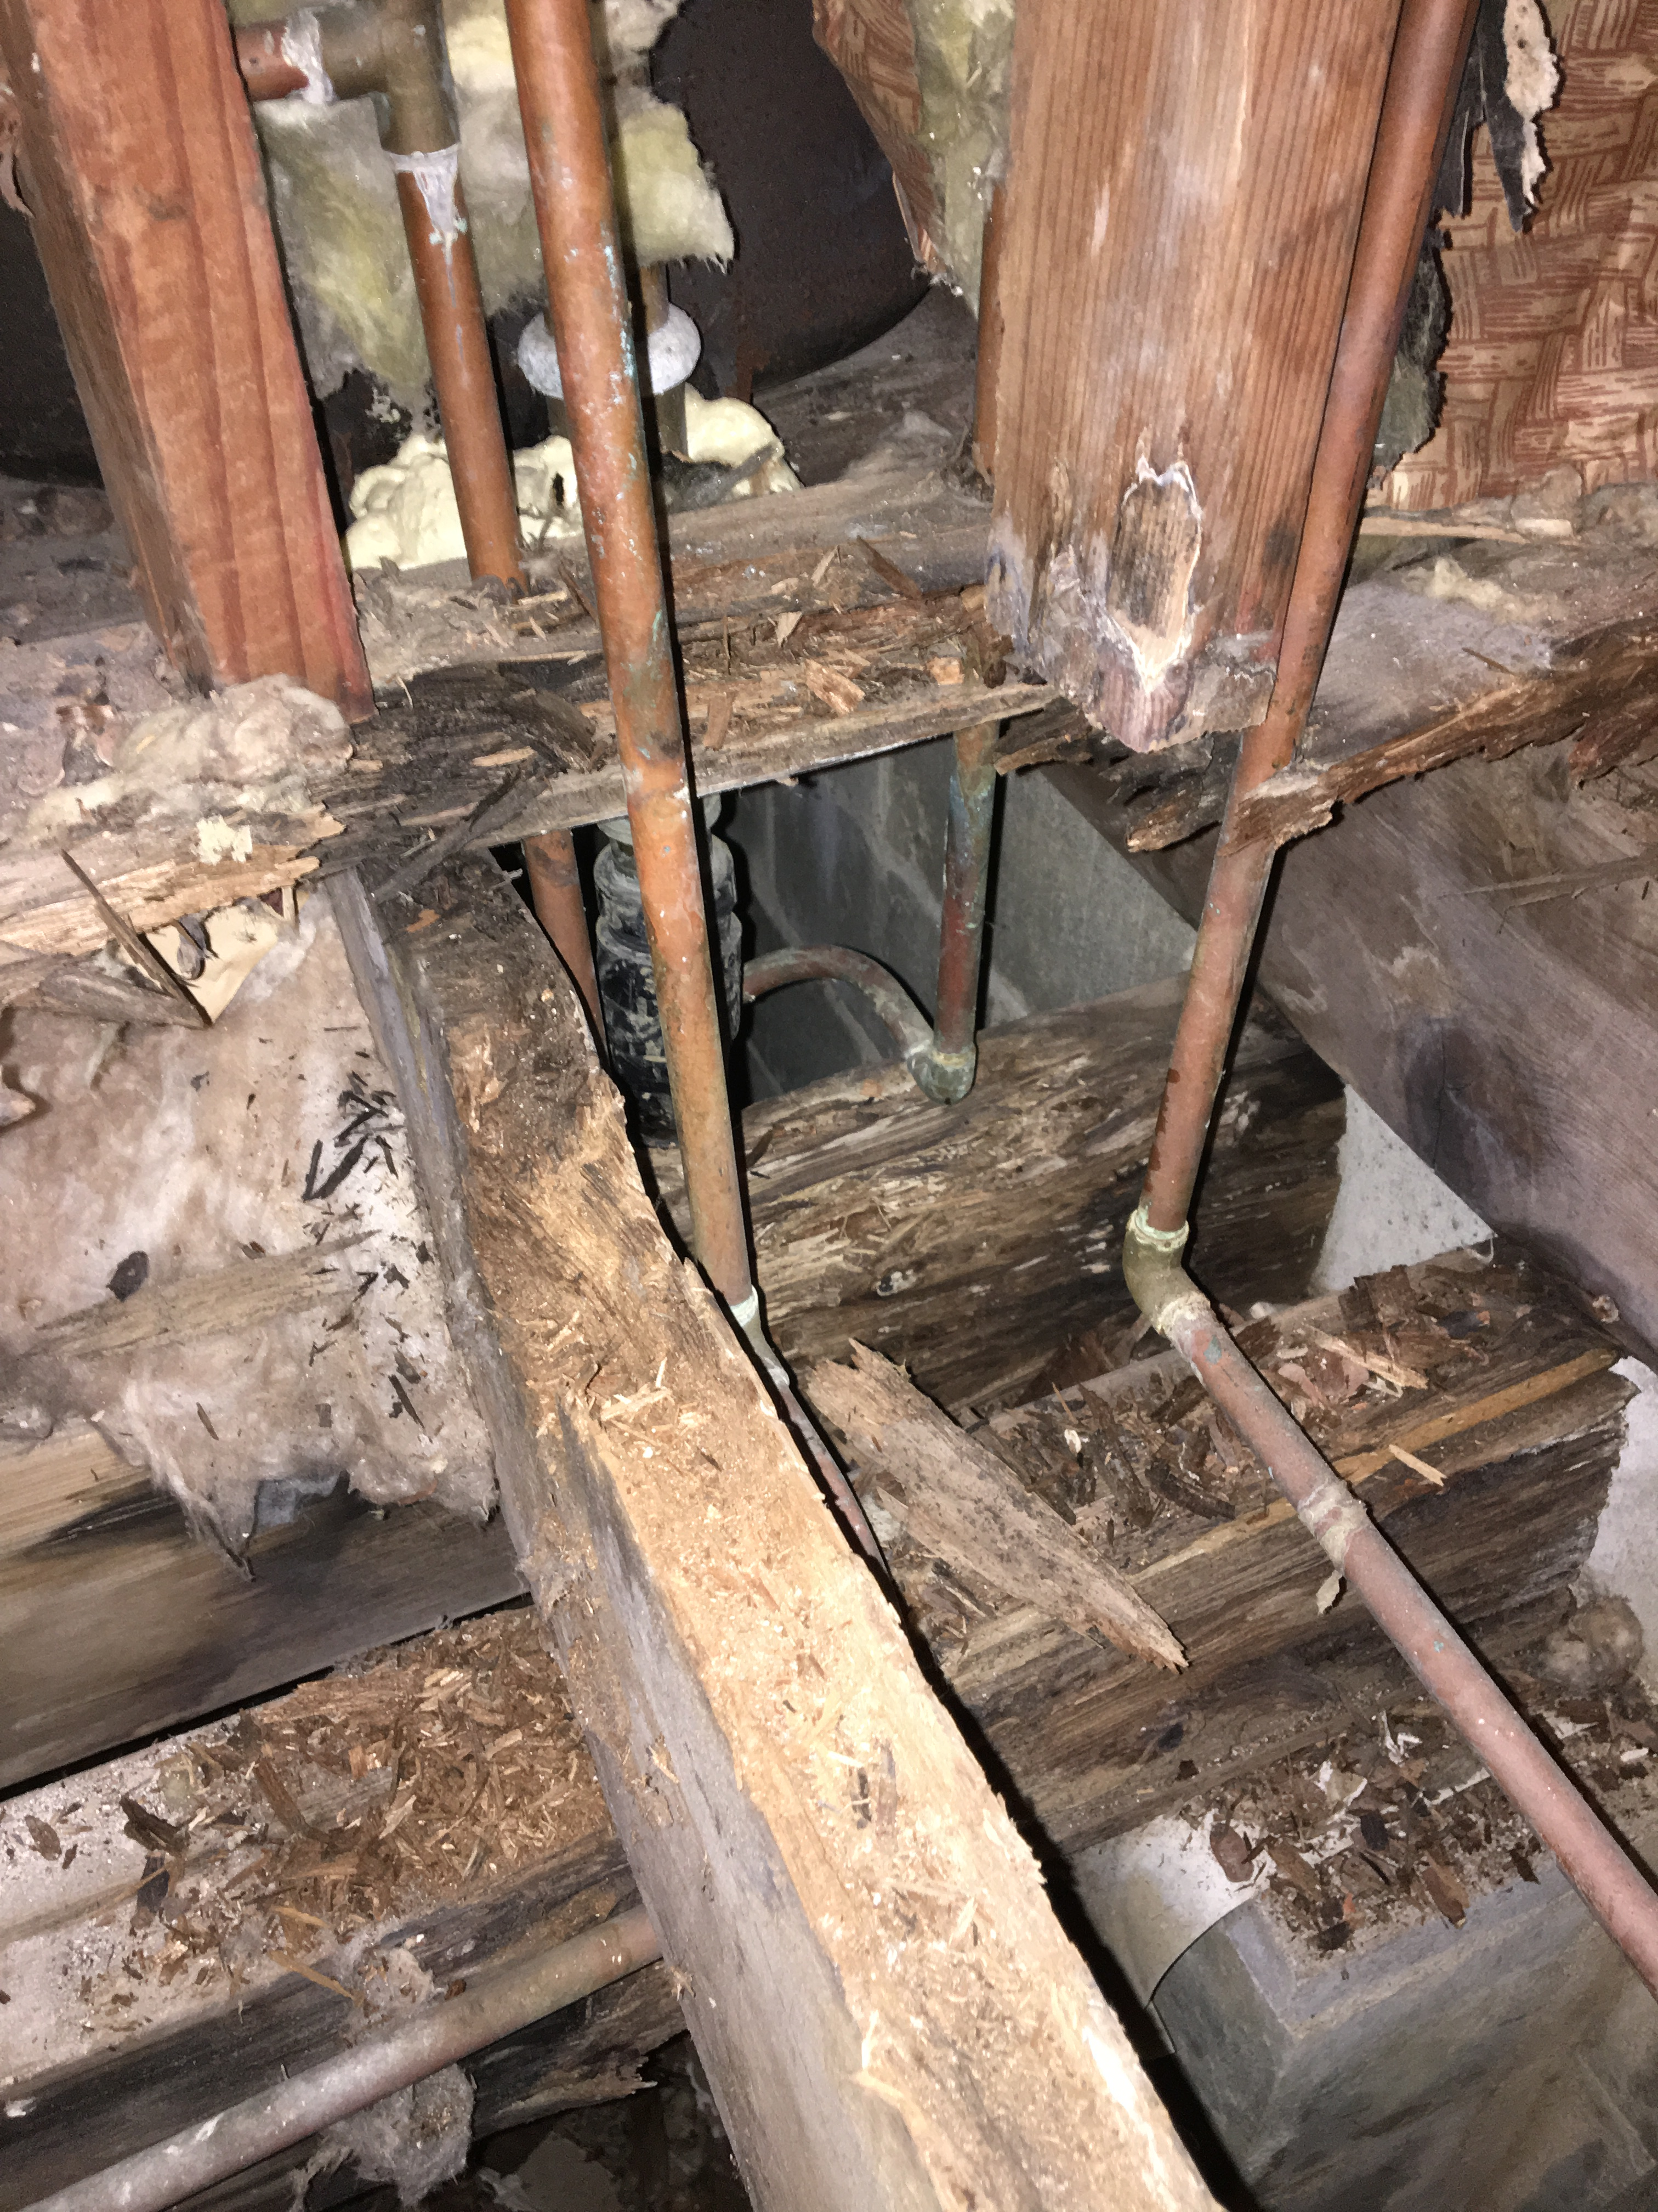
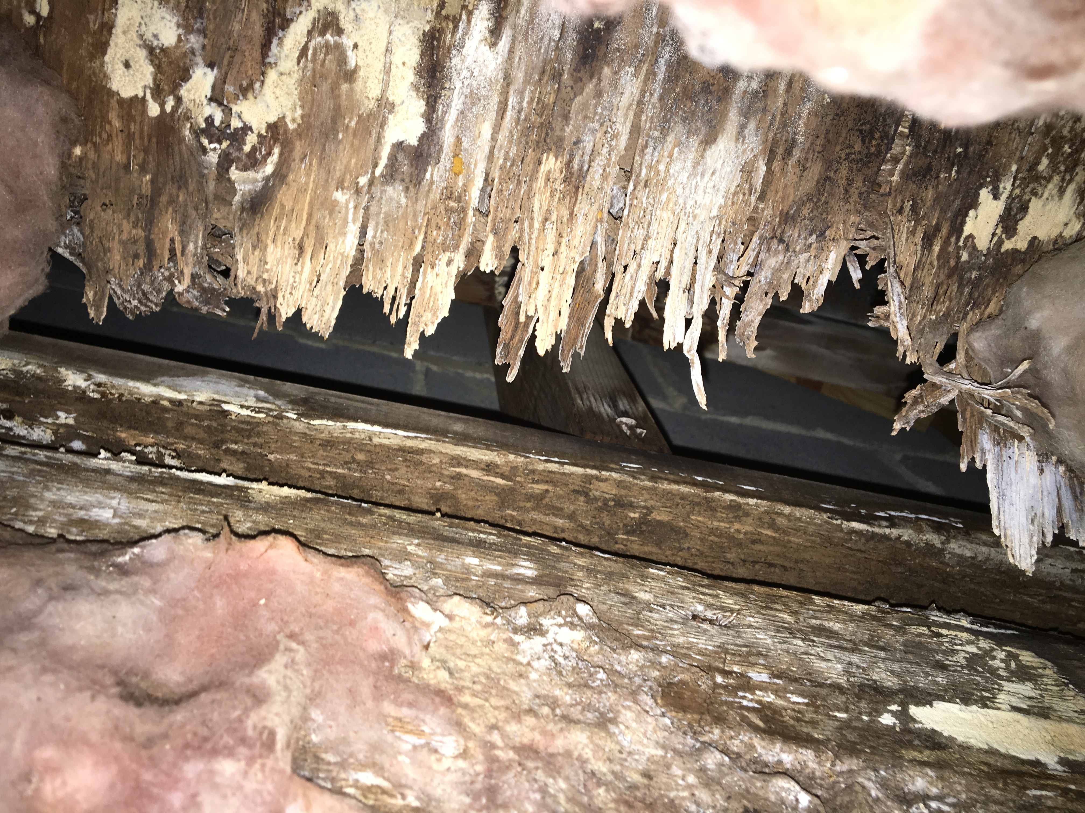
Plumbing
Leak Example

Slide 22
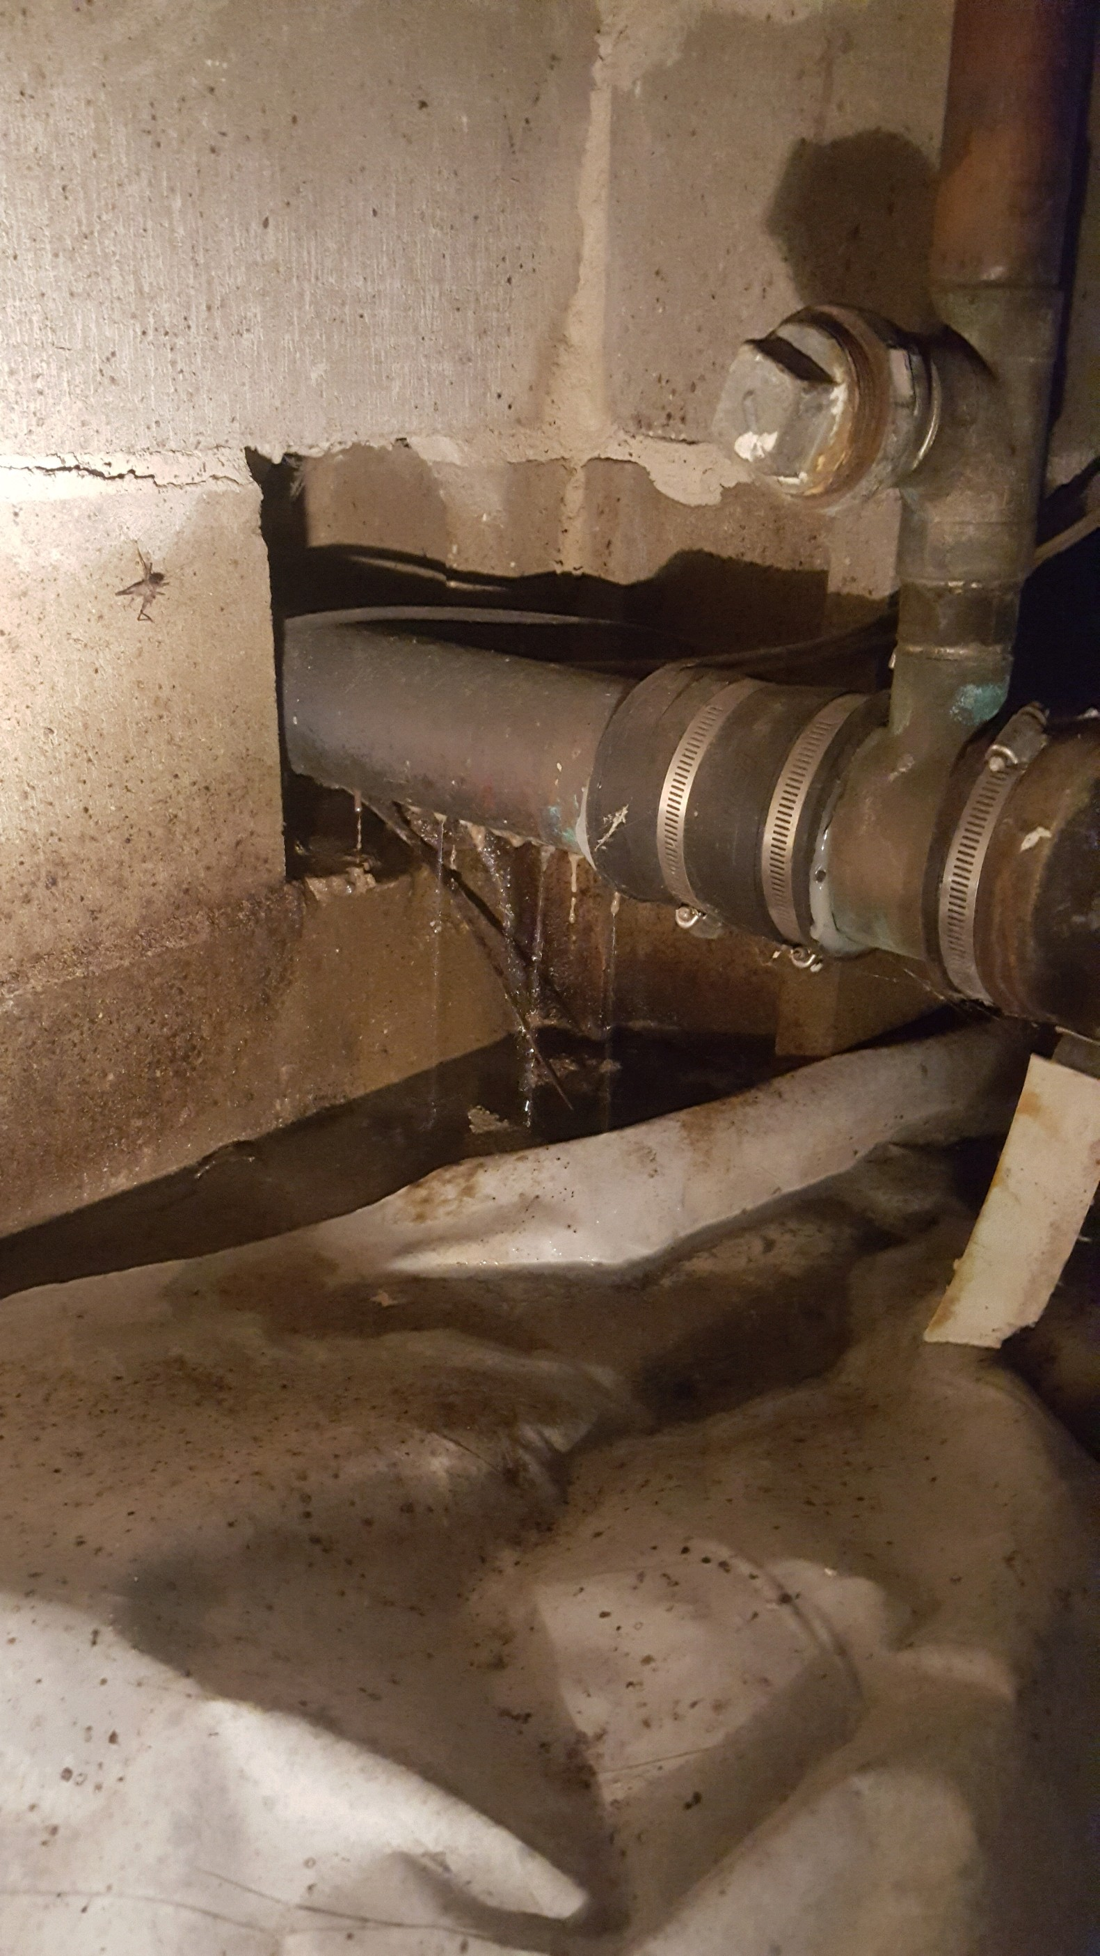
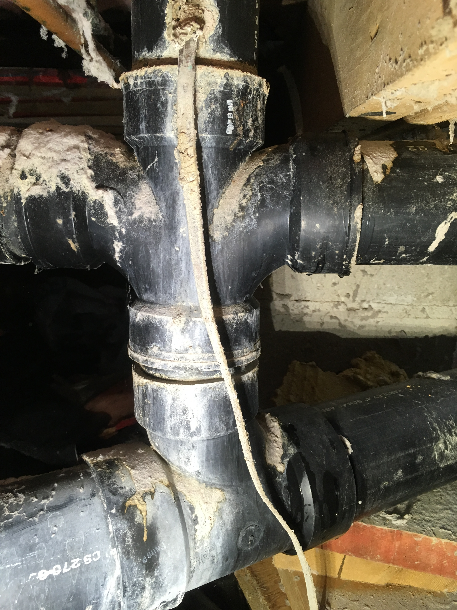
Aging Plumbing System
Major plumbing repairs have been completed recently in units with ‘total failure’. Total average for these repairs have been approximately $10,000 per building.

Slide 23
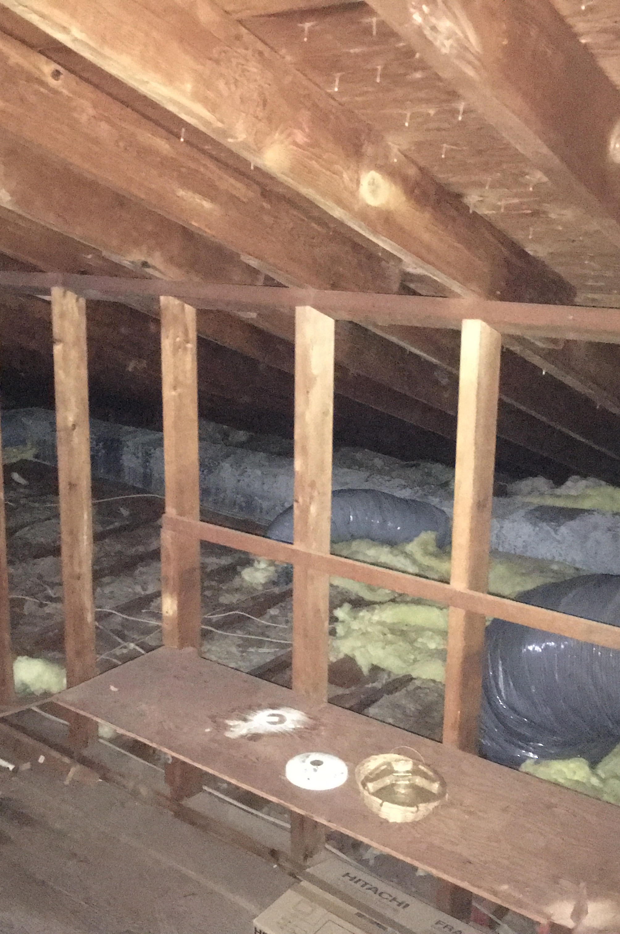
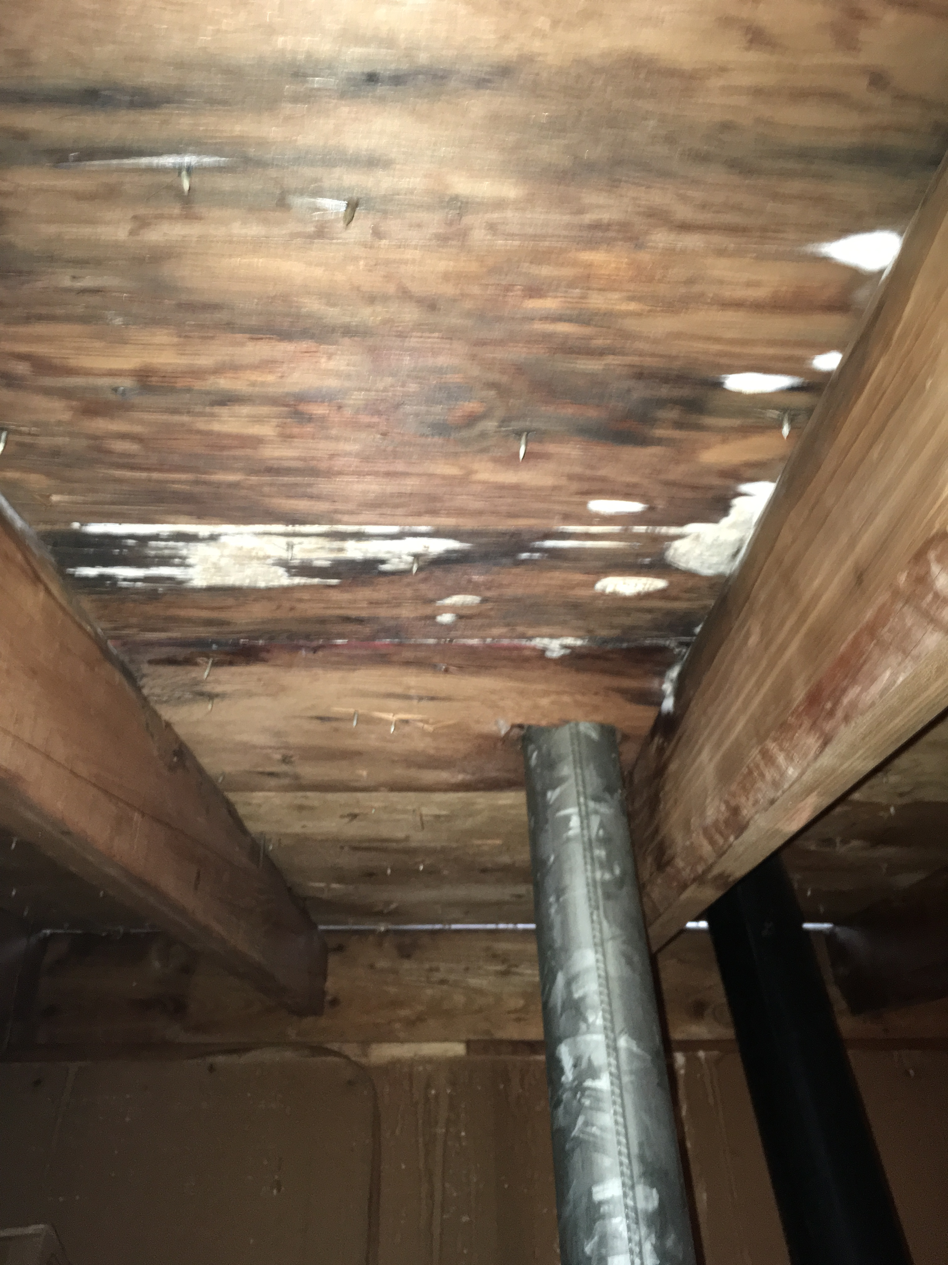
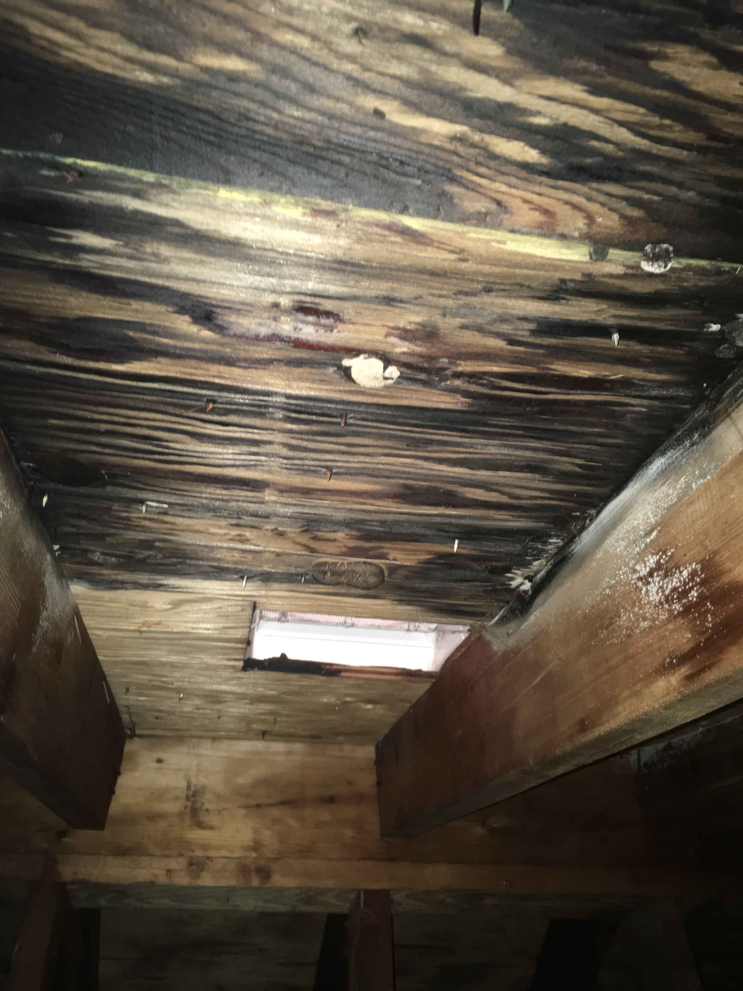
ROOFING

Slide 24
Current Issues
Oldest Roofs are 17 years old.
Scheduled Roof Replacement Program was planned to start in 3 years as designed by Village Engineering Study.
Reported Roof Leaks have grown exponentially over the last 2 years.
Approximately a third of all buildings had a repair made throughout Village 1 from August 2018 to present.
The repairs included minor repairs (replacing rooftop vents) to major repairs in which we had to replace the entire roof.
A common driving force for this replacement need is inadequate attic ventilation.
The Co-op has completed 10 full ‘emergency’ roof replacements due to these reasons over the last year

Slide 25
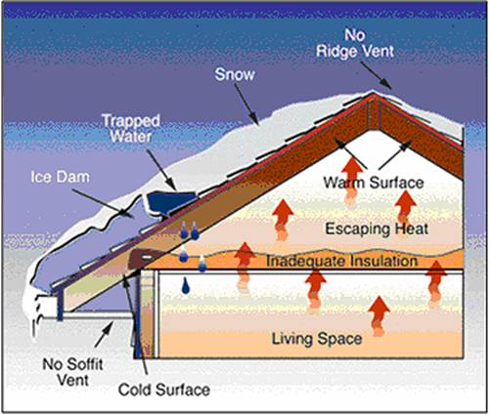
Improper Attic Ventilation
‘Inside Out’ Rotting
Bath Fans venting into attic space adds to the issue

Slide 26
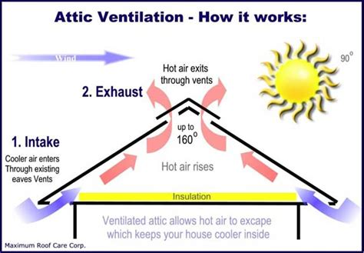
Proper Attic Ventilation

Slide 27
Future Issues
In order to correctly address these roof issues, the Co-op has begun to do complete roof replacements. Included is:
  All roof sheathing is replaced as needed
  All bath and kitchen exhaust fans are hard piped to exhaust out of the sides of the units, to remove any potential entry points for leaks and reduce excess moisture in the attic
  Soffits are then fully opened and finished with fully vented vinyl soffit.
  Cost per building for roof replacement can range from 7-18k depending on the size of the building and the extent of the issues.

